Slide 1
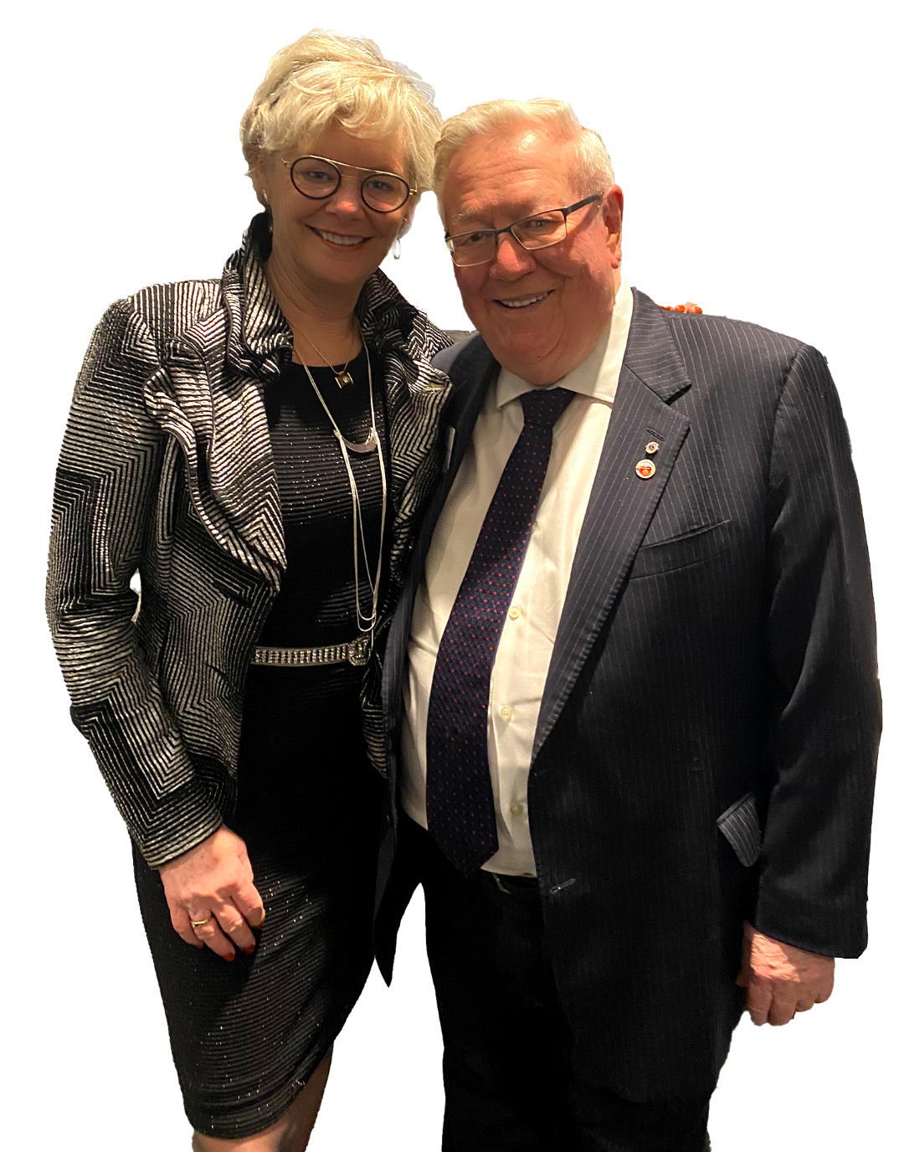
Digital & Social Media Marketing
Today & Tomorrow
Learning Session #1

Slide 2
Why Marketing? Why Now?
Lions International has been developing marketing material and urging clubs to market their individual clubs more and more. Marketing is an important part of keeping our clubs alive. Through Marketing tactics, our Lions clubs are able to showcase the important work that we do and gain community awareness in the areas we serve. Marketing is not just about sales or obtaining donations, it is about awareness and telling the Lion’s story.
The pandemic has hit all industries really hard and changed the way that many organizations operate. It has required organizations to pivot the way that they provide their service very quickly and to include digital tools. As a service, volunteer-based organization, the pandemic affected us in multiple ways. We needed to change how we met with each other, how we provided our services, and it effected the communities that we service in the largest ways.
In an article written by William Joseph on Oct 18 2021 it states “research shows that 42% of charities have created new programs and 54% have transitioned in-person programs online since the beginning of the pandemic. In other cases, organizations have been forced to suspend or cease programs all together.” This shows that many organizations were not able to switch and utilize digital tools and unfortunately were not able to stay afloat. The article outlines that the need for assistance is growing but the ability to reach the communities that need the assistance is harder to reach. This article is an insight into how Marketing can assist an organization in communicating with the community where the community is. People are looking to work with organizations that share their values, and morals. They are interested in donating to organizations that they have an emotional connection with.

Slide 3
LCI Brand & Brand Guidelines
In support of marketing efforts, the Lions organization has created Brand Guidelines and Marketing kits: including social media marketing kits for the clubs to utilize. You can view and learn more about the LCI brand and marketing guideline by clicking here. Take some time to read through and understand the tone of voice, the colours, and imagery that the Lions have associated with the brand.
On the International site there are images, logos, templates, videos and many other tools and files to assist with your marketing material creation. On the site you can also gain access to the editing tool that is suggested by the organization, Canva. For easy access, you can also click here to get to the site and download this tool to start using it.
Brand Importance: Why should we follow brand guidelines:
An article by Ruby Porter marketing & design published on Feb 15, 2019 discusses 5 reasons that brand guidelines are important. They are as follows:
They ensure consistency through a set of rules that outline how the logos, and colours should be used. This ensures that the brand is recognizable to others while ensuring that the brand goals remain focused and are portraying the organizations values.
Take some time to read the article to obtain further information to the benefits of using the brand guidelines and protecting the brand image.

Slide 4
Social Media Marketing
Social Media is defined as “websites and applications that enable users to create and share content or to participate in social networking.” (Oxford Languages)
Social Media Platforms are the sites where the networking and conversations are taking place. There are hundreds of social media platforms but and article by Buffer published March 15 2023 outlines the top platforms that people are using.
Some facts from the article state:
“Facebook is the largest social networking site, with nearly 3 billion people using it monthly. This means roughly 37% of the world’s population are Facebook users.”
“Twitter, a platform with about 238 million monthly active users.”
“TikTok is a short-form video-sharing app. Despite only launching in 2017, it’s one of the fastest-growing apps in the world and recently overtook Google as the most visited internet site.​”
This article provides lots of information about the social media platforms available. Please search and learn more about the demographics and platforms that could be assets to your specific clubs community.

Slide 5
Facebook Overview
When creating your Facebook account it would be suggested to create the account using a Lion’s club email address and setting the account up as a not for profit business account.
A Marketing team should be set up within each club that is able to manage the creation and the publishing of the campaigns on Facebook account. There are many uses that Facebook can be used for but the main use for the Lion’s to start with is awareness. With so much of the work on Facebook platform it is a great place to showcase the work that the Lion’s do to serve the community.
The Marketing team for each club should learn as much as they can about the Facebook platform and how it can be used to bring awareness to the club, the events and the fundraising events.
Click here to access a website that explains how Facebook can help with Fundraising.
Click here to access an article that explains how Facebook can help not-for-profit organizations
Click here to access Facebook Free educational courses offered through Meta
Click here to access an article that explains the 10 top Facebook terms

Slide 6
Future State Marketing Possibilities
With the development of a new website for the district and the ability for the clubs within District 4A site to have subsites that are connected to the main site will be many other options and abilities for the Lion’s story to be shared. With this new site the marketing options will be opened to many other tactics such as Blogs, Instagram, Twitter, Facebook etc. These platforms are all available to use independently but with an interactive site this is significantly easier to ensure that the posts are connected.
With the new website we will be able to share, and save images that are created for social media posts among clubs within the district. This will provide the district with a place to keep the blogs, history and stories of the different clubs in the district. This will provide us content to share and utilize in awareness campaigns.
This is a journey that the Lions in District A4 is on to enhance our clubs and highlight the great and meaningful work that each of the clubs in this district do!
For more information please feel free to reach out to Dan Tucker or Billie Duffield at dantucker6@yahoo.ca or dbillie_jo@yahoo.ca

