Slide 1
District OH7
Secretary Training Millersport Lions Clubhouse
2905 Chautauqua Blvd, Millersport OH 43046
January 31, 2026
C/S Cathy Dardis
Notes:
As a new club secretary you will need to set up a notebook to retain club members, roll call, agenda’s and board and club minutes.

Slide 2
You can set up your notebook anyway that works for you. At a minimum, it should contain the club roll call, club members contact list, committees, meeting agenda, minutes and the club constitution and by-laws.

Slide 3
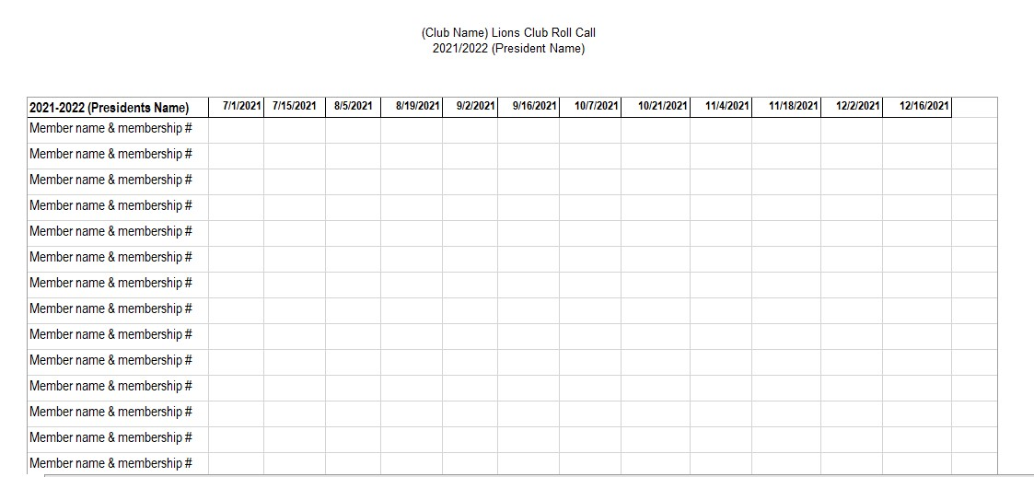
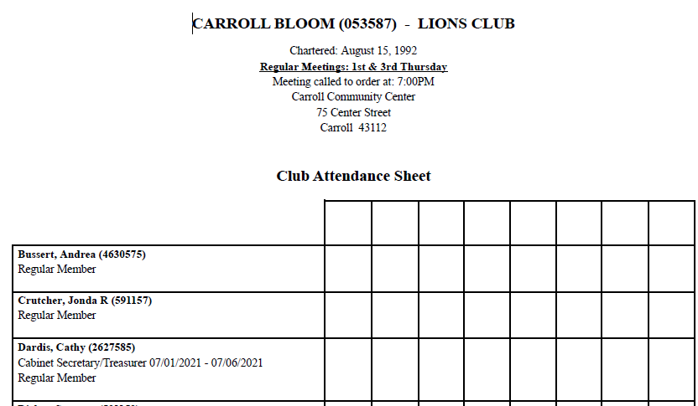
Notes:
Listed here is a spreadsheet or club attendance you can obtain off the LCI portal for roll call

Slide 4
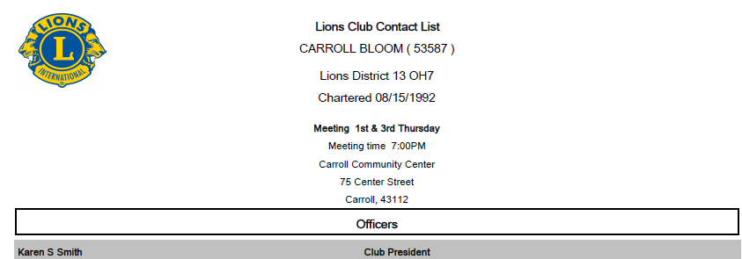
Notes:
This is a look at the “Lions Club Contact List” on LCI Portal. I only listed the first person, however it will have all members on the report.

Slide 5
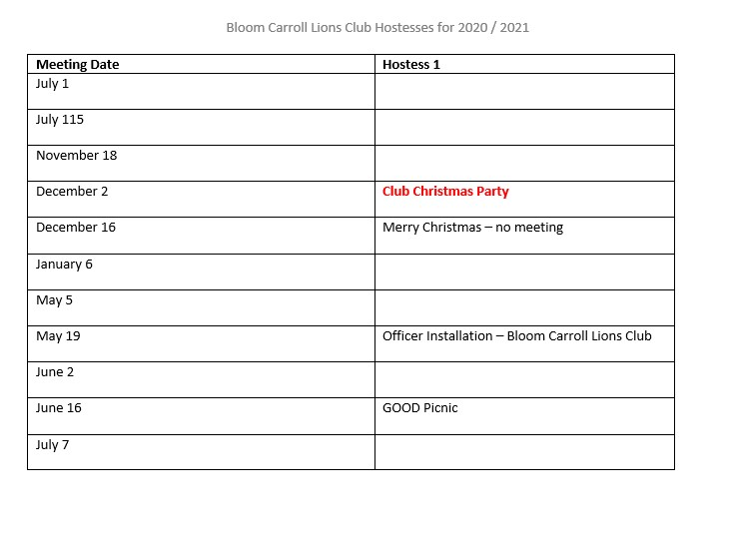
Notes:
Each club is different, however at my club we only have desserts, so we have a sign up sheet for members.

Slide 6
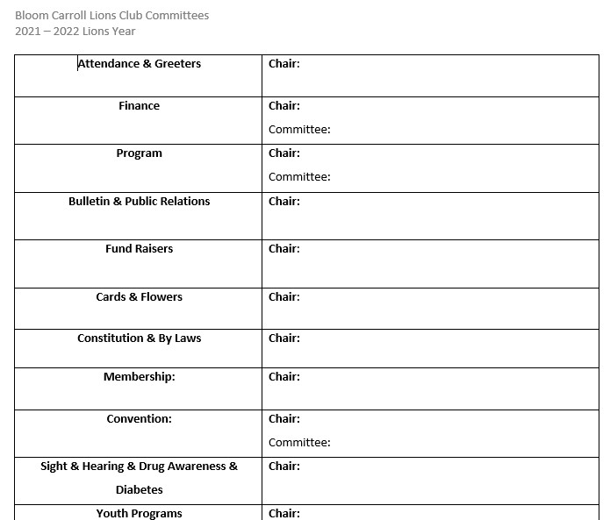
Notes:
This is a list of committees and is passed around for members to sign up for.

Slide 7
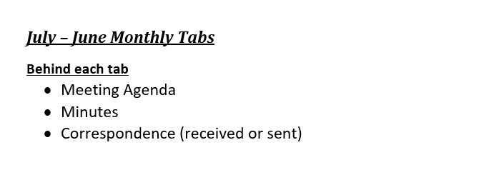

Slide 8


Slide 9
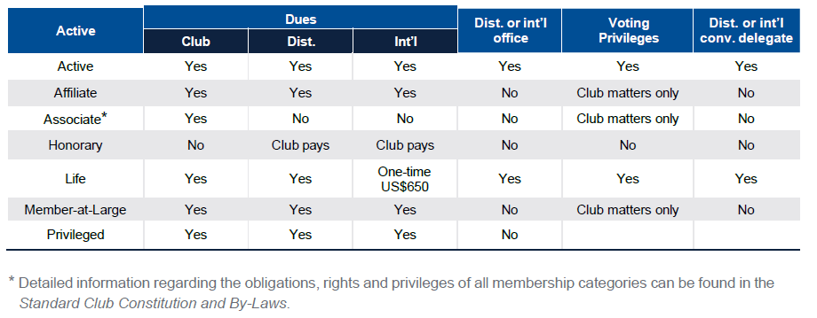
MEMBERSHIP TYPES & CATEGORIES
New member
Transfer member
Family member
Student member
Current of former Leo
Young adult
Active member
Affiliate member
Associate member
Honorary member
Life member
Member-at-Large
Privileged member
Notes:
ME-105 5/23

Slide 10
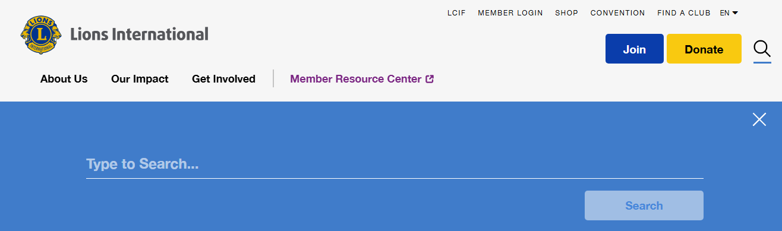
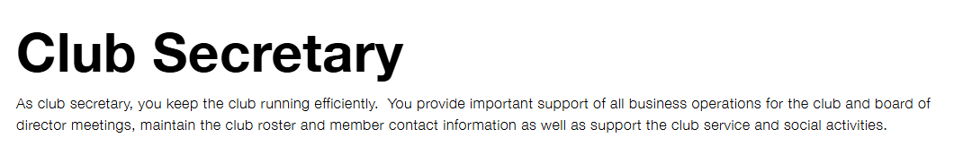
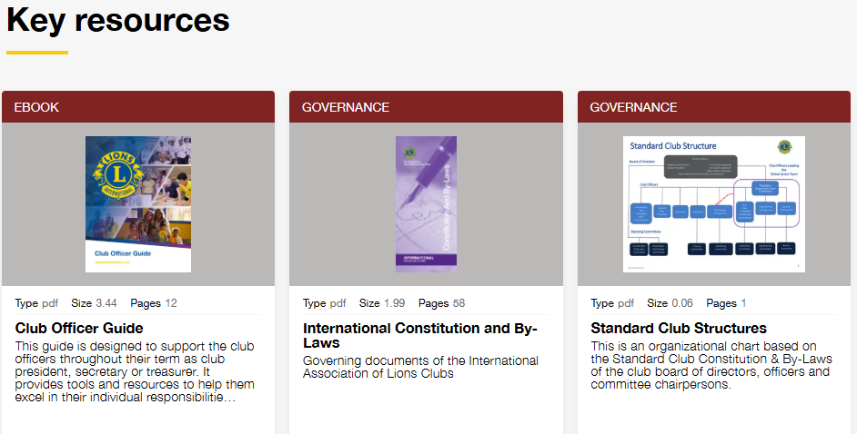
Notes:
LCI Resources

Slide 11
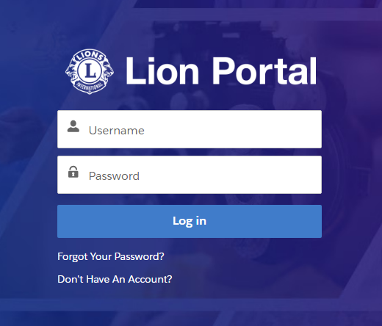
Notes:
The Portal

Slide 12
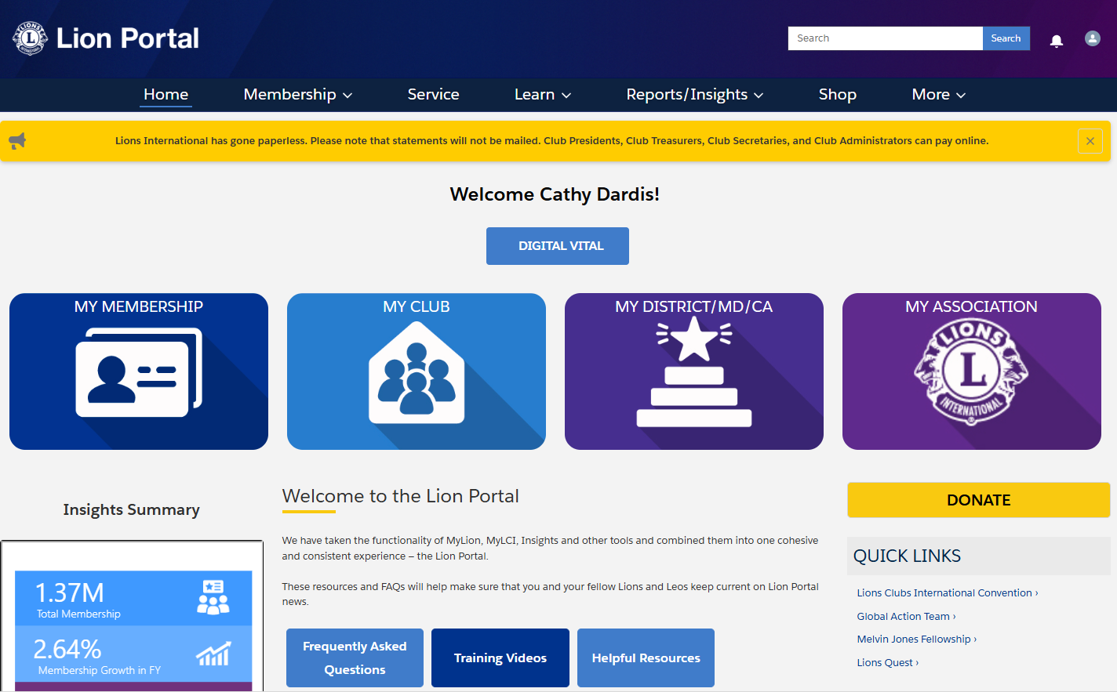
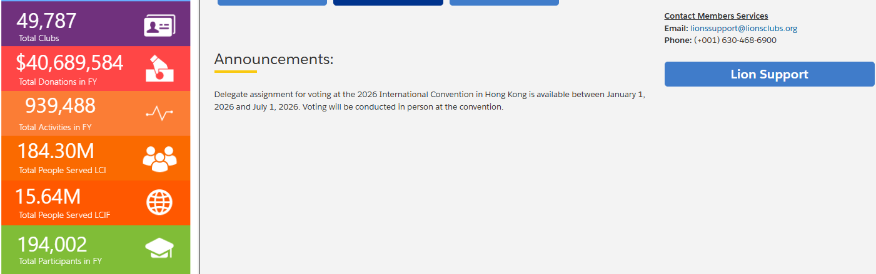
Notes:
Click on My Club

Slide 13
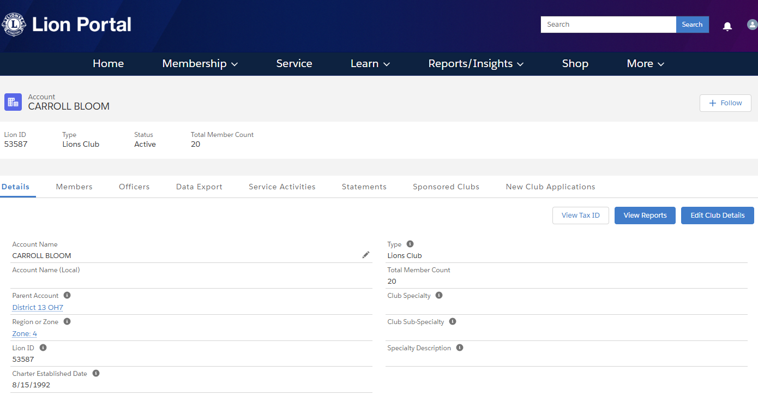

Slide 14
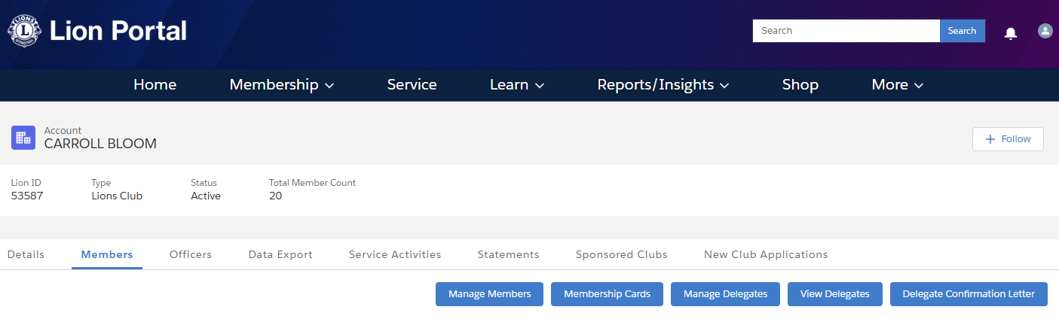

Slide 15
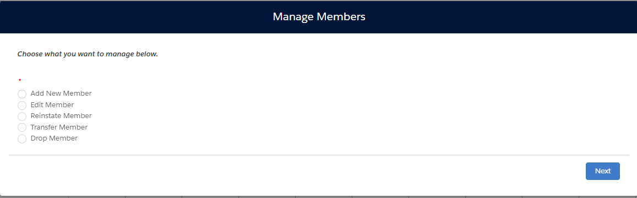
Notes:
How to Add a Member

Slide 16
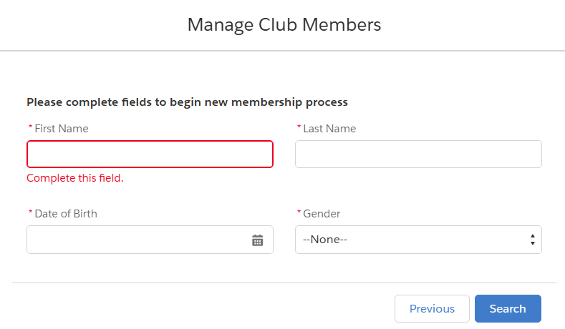
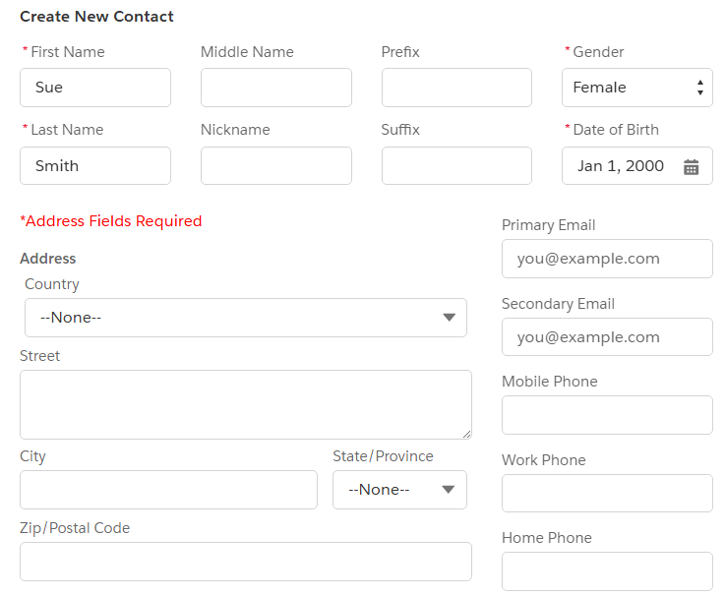

Slide 17

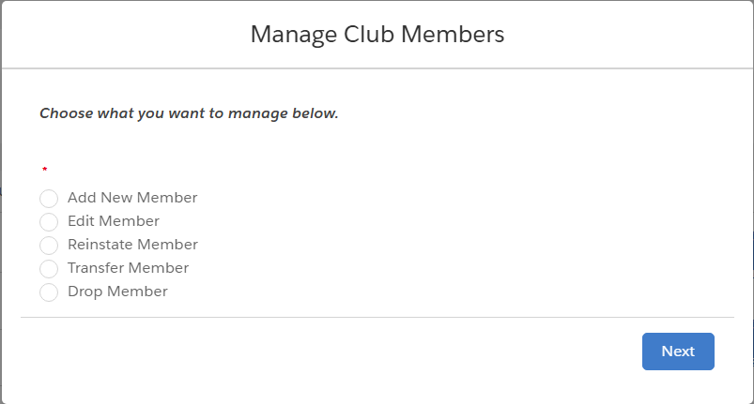
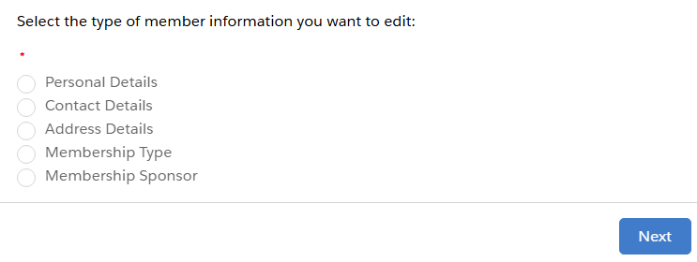
Notes:
How to edit a member

Slide 18

Notes:
Service

Slide 21
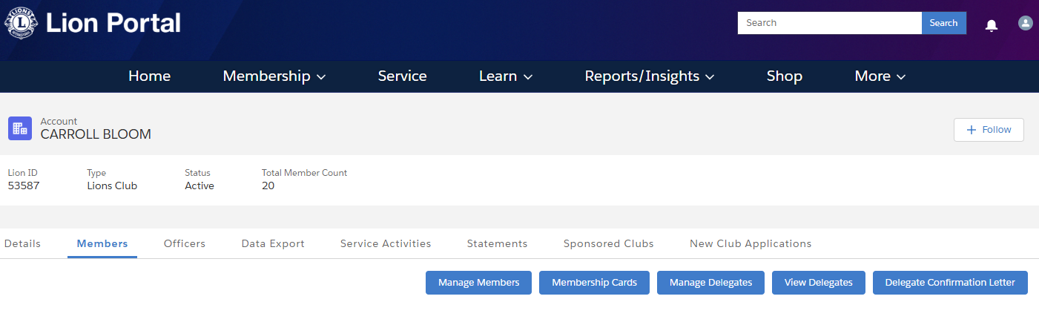

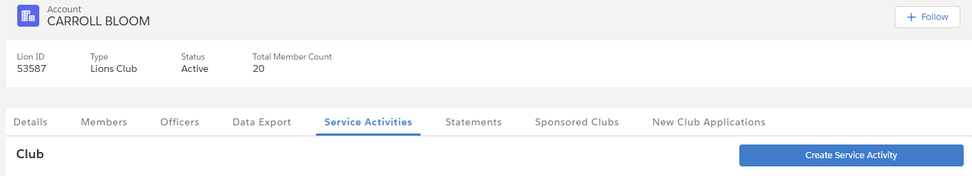


Slide 22
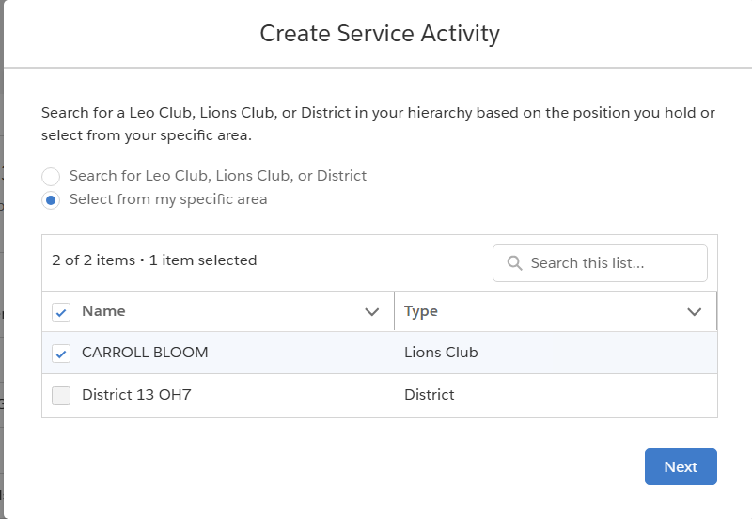

Slide 23
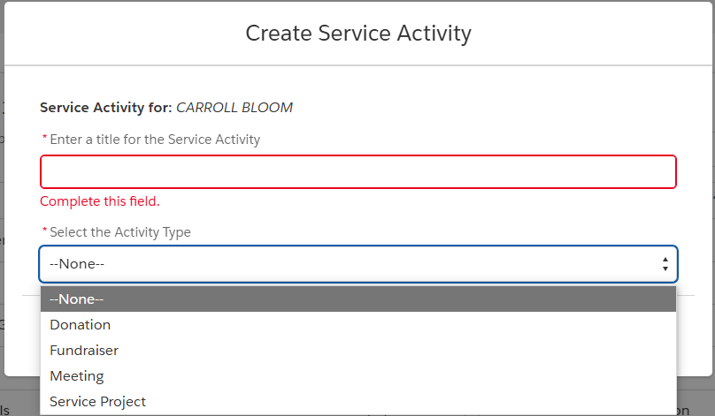


Slide 24
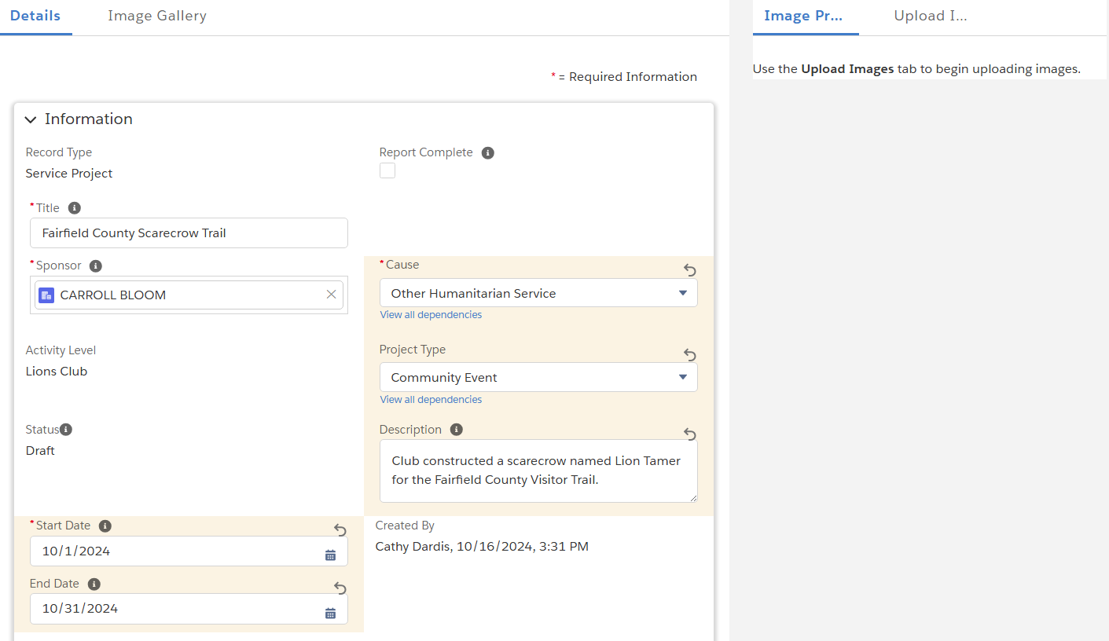

Slide 25
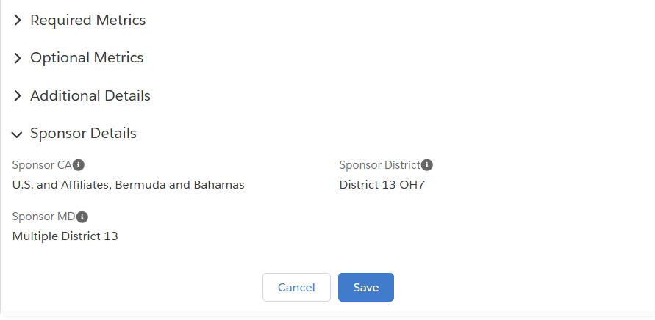
After you have checked report complete, be sure to save your activity, this will report it.
Notes:
Must complete the required metrics. You can save the activity for completion later, in case you want to upload an image. On the previous slide--- you must it report complete for it to be considered reported.

Slide 26
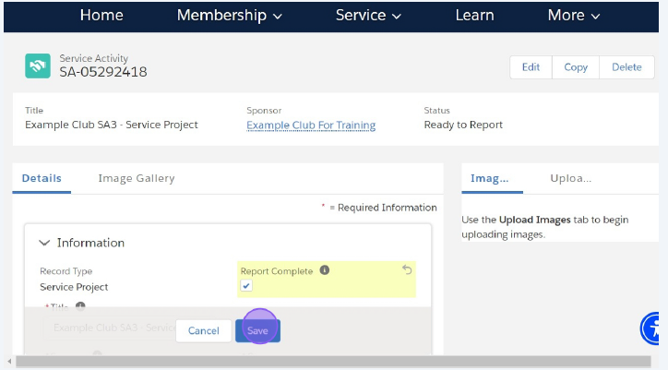
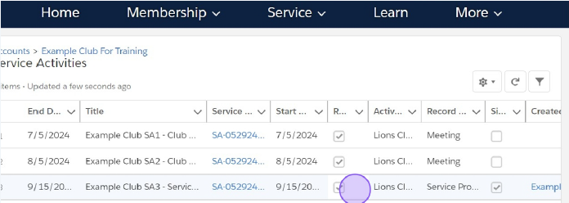

Slide 27
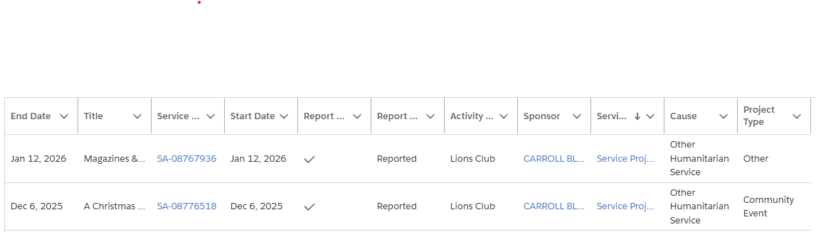
Be sure to go back and check that the service activity has been reported.

Slide 28
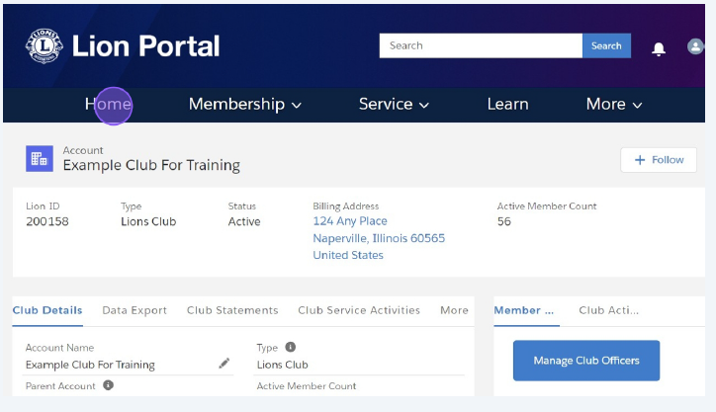

Slide 29
Email the passcode to PDG Sara Camacho
lionsaracamacho@gmail.com
Passcode: We Can
Lion Cathy Dardis
(740) 407-6632
5718 Havensport Rd
Carroll, OH 43112
cmred2000@gmail.com

