Slide 1
Lions Member Orientation
Michigan
District 11-B1
North American Membership Committee 2021
Notes:
Trainer Tip: Enter other information as you see fit, such as the name of the New Member Orientation trainer.

Slide 2
Member Orientation Summary
Member orientation is broken out into four sections:
Who Lions Are
Lions Clubs International (LCI)
History
Organization
LCIF
District and Multiple District
Our Club

Slide 3
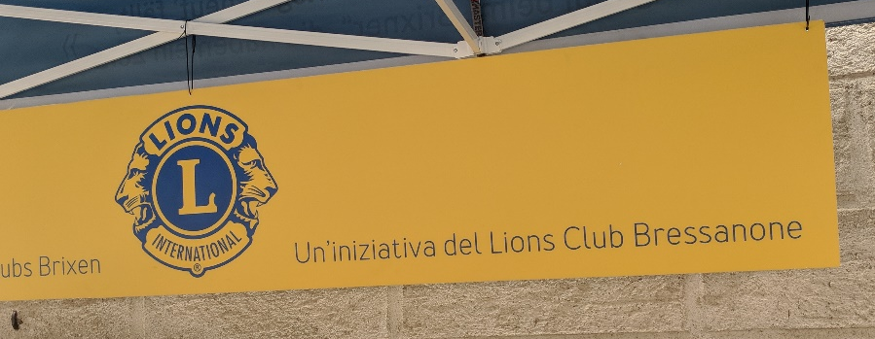
Who Lions Are
Lions are men and women dedicated to serving those in need, in their own community or around the world.
Nearly 1.4 million members
Over 200 countries
More than 46,000 clubs
Vision Statement: To be the global leader in community and humanitarian service.
Mission Statement: To empower volunteers to serve their communities, meet humanitarian needs, encourage peace and promote international understanding through Lions clubs.
Motto: “We Serve”

Slide 4
Purpose of Lions
To Organize charter and supervise service clubs to be known as Lions clubs.
To Coordinate the activities and standardize the administration of Lions clubs.
To Create and foster a spirit of understanding among the world’s people.
To Promote the principles of good government and good citizenship.
To Take an active interest in the civic, cultural, social, and moral welfare of the community.

Slide 5
Purpose of Lions (cont.)
To Unite the clubs in the bonds of friendship, good fellowship, and mutual understanding.
To Provide a forum for the open discussion of all matters of public interest; provided, however, that partisan politics and sectarian religion shall not be debated by club members.
To Encourage service-minded people to serve their community without personal financial reward, and to encourage efficiency and promote high ethical standards in commerce, industry, professions, public works and private endeavors.

Slide 6
Membership
The benefits of Lions club membership are numerous:
Helping those in need
Making a difference in your community
Having an impact on those in need worldwide
Developing leadership skills
Enhancing communication skills
Utilizing planning and organization skills
Working hands-on to meet community needs
Meeting new people
Opportunities to network
Opportunities to travel

Slide 7
Lions Clubs International

Slide 8
In the Beginning…..
In 1917, Melvin Jones, a 38-year-old Chicago business leader, told members of his local business club they should reach beyond business issues and address the betterment of their communities and the world. Jones' group, the Business Circle of Chicago, agreed. Then after contacting similar groups around the United States, an organizational meeting was held on June 7, 1917, in Chicago, Illinois, USA. The new group took the name of one of the invited groups, the "Association of Lions Clubs," and a national convention was held in Dallas, Texas, USA in October of that year. A constitution, by-laws, objectives and a code of ethics were approved. And the rest is history.

Slide 9
Name
The official name of the association is “The International Association of Lions Clubs” or simply “Lions Clubs International.”
The name Lions was chosen on a secret ballot over several others because the lion stood for strength, courage, fidelity, and vital action.

Slide 10
Logo
The Lions logo consists of a gold “L” on a blue field surrounded by a gold circle. On either side of the circle is the profile of a Lion’s head, one looking back upon a proud past and the other looking optimistically toward the future.
The logo may be downloaded for member and club use from the LCI website. It is a registered trademark in most countries and should be used according to the guidelines.
https://www.lionsclubs.org/en/resources-for-members/brand-guidelines

Slide 11
The Philanthropic Back-Story
The philanthropic focus of the Lions Club has an interesting back-story.
In 1925, Helen Keller stood before a room full of men at the Lions Club International Convention in Cedar Point, Ohio, asking them to imagine what it's like to stumble around in the dark. In a plea to raise money for the newly formed American Foundation of the Blind, she recounted her own experience with blindness and pleaded with them to join the cause to help more people see the light. "I appeal to you, Lions -- you who have your sight, your hearing, you who are strong and brave and kind -- will you not constitute yourselves Knights of the Blind in my crusade against darkness?“
Since that day, fighting blindness has been the primary focus of Lions Clubs International, which at this time still sponsors free eye screening programs through mobile clinics, pays for cataract surgeries for the poor, and collects eye glasses for those in need.

Slide 12
History
1917: Melvin Jones founded LCI.
1920: LCI becomes international with Canadian club.
1925: Helen Keller challenged Lions to become “knights of the blind.”
1945: LCI helped draft the United Nations Charter.
1957: The Leo Club Program is created.
1968: The Lions Clubs International Foundation is established.
1990: SightFirst is launched.
Today: Our international network has grown to include more than 200 countries and geographic areas.
1987: LCI became the first service club organization to admit women as members.

Slide 13
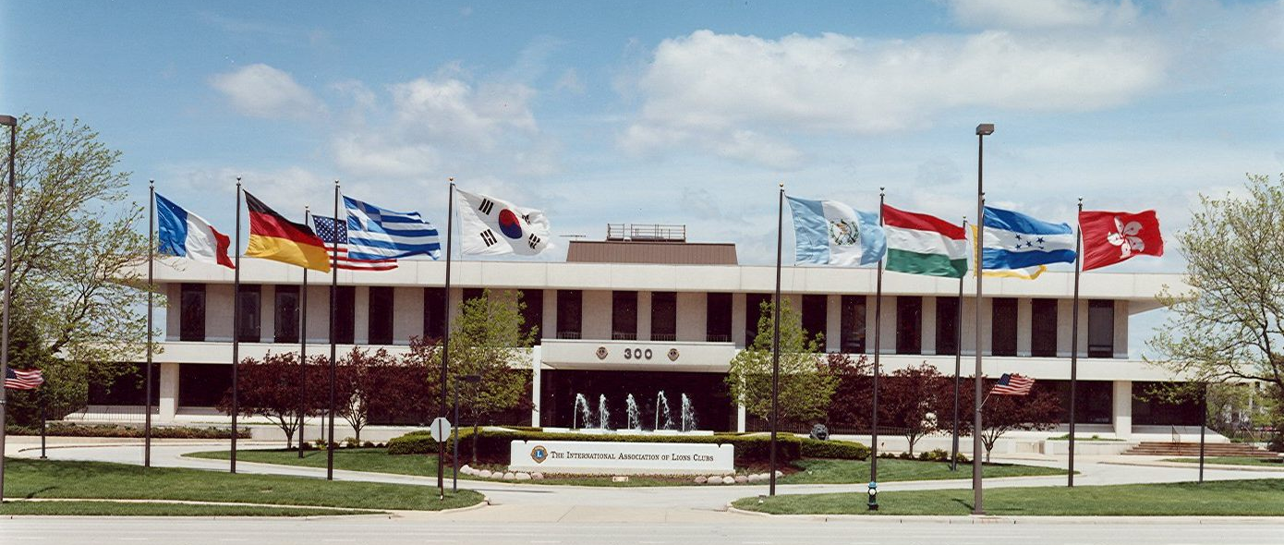
International Headquarters
Located in Oak Brook, Illinois, USA
Approximately 275 staff members in 11 divisions:
Club Supplies and Distribution
Convention
District and Club Administration
Extension and Membership
Finance
Information Technology
Service Activities
Leadership
Legal
LCIF
Public Relations and Communication

Slide 14
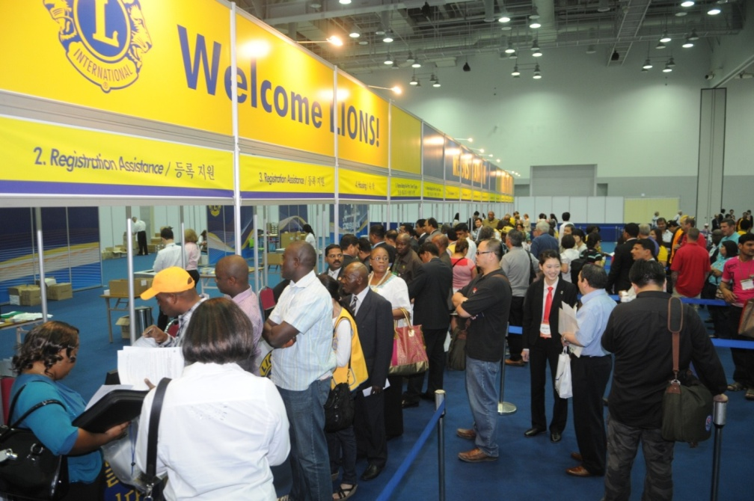
International Convention
Convention brings together thousands of Lions from around the world for a week of business, education, celebration and fellowship.
2013: Hamburg, Germany
2014: Toronto, ON, Canada
2015: Honolulu, HI, USA
2016: Fukuoka, Japan
2017: Chicago, IL, USA*
2018: Las Vegas, NV, USA
2019: Milan, Italy
2020: Singapore (cancelled due to Covid-19 Virus)
2021: Montreal (?)
* 100 Year Celebration

Slide 15
Organizational Structure
International officers implement policy and serve as inspirational leaders of the world’s Lions.
International President: Jung-Yul Choi (South Korea)
First Vice President: Douglas X. Alexander (New York)
Second Vice President: Brian E. Sheehan (Minnesota)
Third Vice President: Patti Hill (Alberta, Canada)
Immediate Past President/LCIF Chairperson:
Gudrun Yngvadottir (Iceland)
The International Board of Directors is the governing body of the association.
34 members and 8 board appointees
The International Constitution and By-Laws govern the operations of the association and establish the rules by which the association is to function.

Slide 16
Global Action Team
The Global Leadership Team (GLT) provides training and leadership development opportunities for all Lions.
The Global Membership Team (GMT) is the driving force for bringing new members into your club. You will develop new friendships and you will ensure your club will have a stronger foundation to serve your community and the world.
The Global Service Team (GST) is the driving force behind community services, disaster preparedness and relief, vision, diabetes, environmental, childhood cancer, and hunger programs.

Slide 17
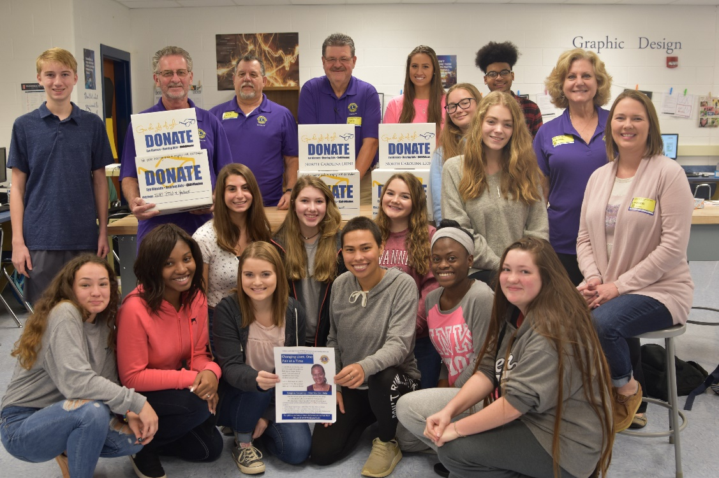
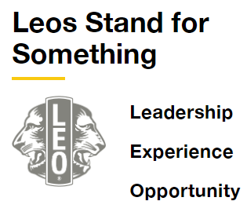
Leo Clubs
As the youngest members of Lions Clubs International, Leos embody the best qualities of our incredible organization. They are devoted young people who realize the power of action.
Together, Leos and Lions form a powerful partnership—one of mutual respect, where Lions learn from the innovative insights of Leos, and where Leos gain access to the proven strategies of those who’ve successfully served the world for decades.

Slide 18
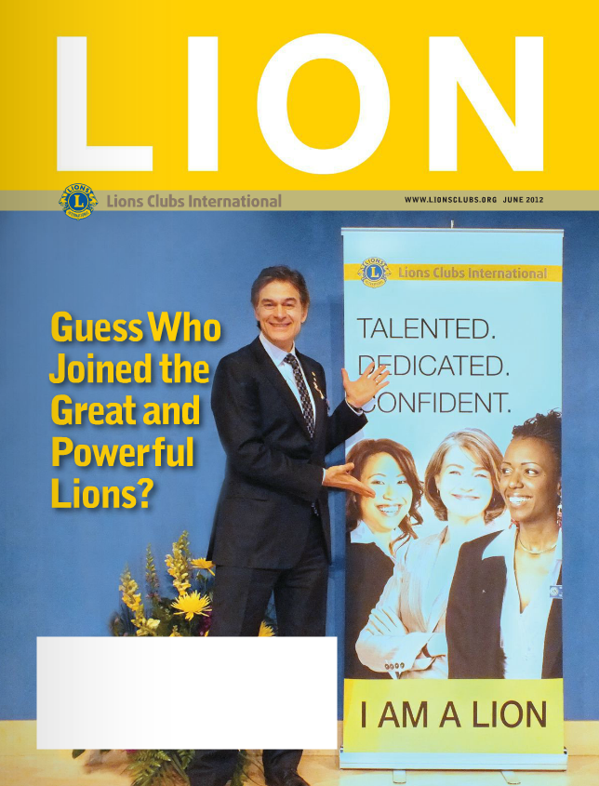
Communications
Lion Magazine (international)
Lion Pride (multiple districts 10 &11)
District Newsletter (district 11-B1)
Club Newsletter
E-mail Messages
Web site
Zoom
Social Media
www.facebook.com/lionsclubs
https://twitter.com/lionsclubsorg

Slide 19
Lions Clubs International Foundation (LCIF)
LCIF is the charitable arm of the Lions Club International (LCI) and is a public, non-profit corporation. Donated funds are disbursed as grants for humanitarian projects, educational service and disaster relief in local communities as well as for projects that have global impact. LCIF receives contributions from individual Lions, Lions Clubs, corporations, and other foundations.
Since its founding in 1968, LCIF has approved more than $220,000,000 for humanitarian service projects that have improved the quality of life in thousands of communities worldwide.

Slide 20
LCIF Grant Categories
Sight First
Matching
Diabetes
Designated
Disaster
Lions Quest
LCIF Leo Service
Humanitarian Award Winners
District/Club Community Impact
Hunger
Childhood Cancer
Notes:
https://www.lionsclubs.org/en/lcif-grants-toolkit

Slide 21
District and Multiple District
Mission Statement – The Lions of Michigan will support the mission of Lions International and will serve Michigan communities, support Lions district, state, and international projects and promote membership, leadership, and training at all levels. Vision Statement – The vision of the Lions of Michigan is to serve the needs of people in our communities, preserve sight and hearing through our existing state projects, new state projects, and partnerships with other organizations in the state of Michigan.

Slide 22
Organizational Structure – Multiple Districts
Lions Clubs throughout the world are grouped into approximately 750 districts, each with its own District Governor.
The governors within a multiple district constitute a Council of Governors.
Multiple District 11 (MD-11) encompasses all of the lower peninsula of Michigan.
Single District 10 (SD-10) encompasses the upper peninsula.

Slide 23
Districts of Michigan
Notes:
Trainer Tip: Consider adding additional information about your district and multiple district, such as the district governor’s name and the boundaries of your district and multiple district.

Slide 24
Organizational Structure – Multiple Districts

Slide 25
Organizational Structure – Multiple Districts
The District Governor (DG) is the chief administrator for the district cabinet and chairperson of the Global Action Team (GAT).
GAT members organize conventions, oversee elections, provide leadership training, promote LCI programs, and encourage membership retention.
The DG is assisted by the 1st and 2nd Vice District Governors (VDGs), Cabinet Treasurer (CT), Cabinet Secretary (CS).

Slide 26
Governance Structure for District 11-B1
Our multiple district is divided into Regions and subdivided further into Zones.
Zone Chairs (ZC) serve on the district cabinet. They serve as a communication link between clubs and the DG, help with organizing new clubs, reporting activities, and supporting the well-being of clubs.

Slide 27
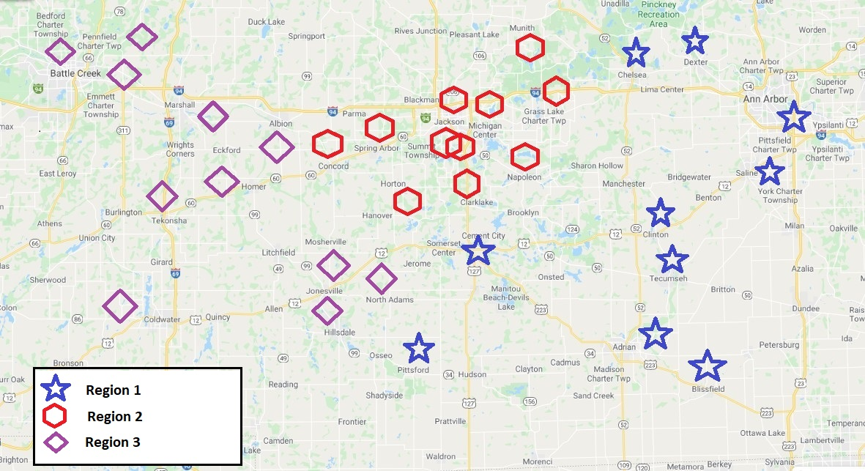
Map of District 11-B1
Notes:
Trainer Tip: The points on this map indicate club locations within the district, with unique designators for the regions. This map can be modified to indicate zones, club names, etc as presenters see fit.

Slide 28
Our District Clubs
Adrian Breakfast
Adrian Evening
Albion
Ann Arbor Evening
Ann Arbor Host
Battle Creek Cereal City
Battle Creek Host
Bedford Area
Blissfield & Area
Branch Area
Chelsea
Clarklake
Clinton
Concord
Dexter
Grass Lake
Hanover Horton
Hillsdale
Homer
Huron Valley Sunrise
Inter Lakes
Jackson Cascades
Jackson County Professional Virtual
Jackson Eye Openers
Jackson Host
Jackson Lions Diabetes Service
Jonesville
Manchester
Marshall
Michigan Center
Michigan Center Lioness
Munith
Napoleon
North Adams
North Jackson
Parma Spring Arbor
Pennfield
Pittsford Area
Quest South East Jackson
Saline
Tecumseh
Tekonsha
University Of Michigan Campus
Vandercook Lake

Slide 29
District Convention
District conventions are held to:
Develop fellowship among the Lions of the district
Conduct general district business
Elect the district governor and other officers
Conduct seminars to further knowledge of the Lions organization, our service projects, and leadership training
District 11-B1 typically holds its convention in April.

Slide 30
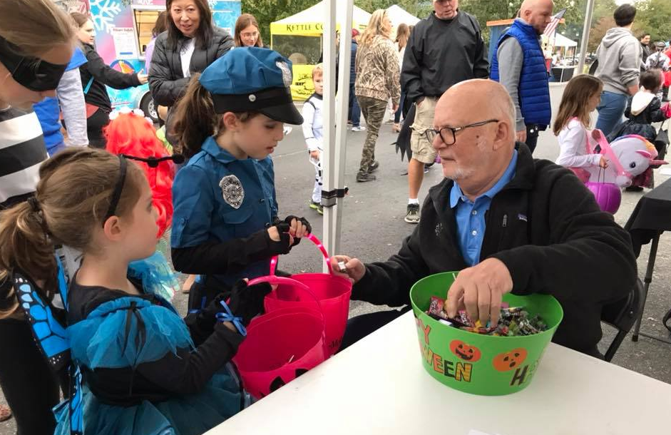
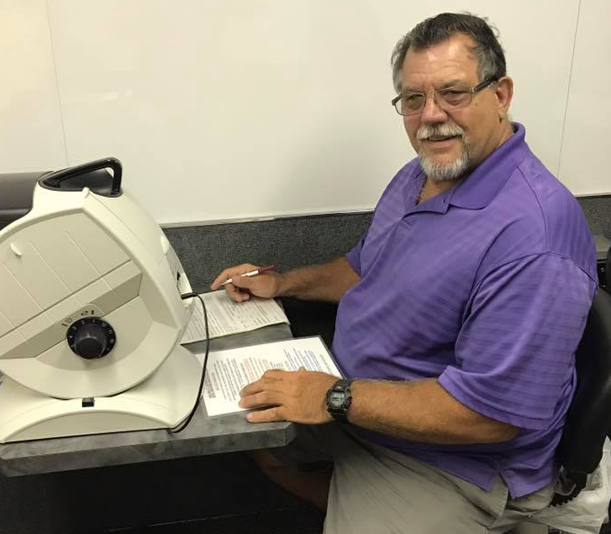
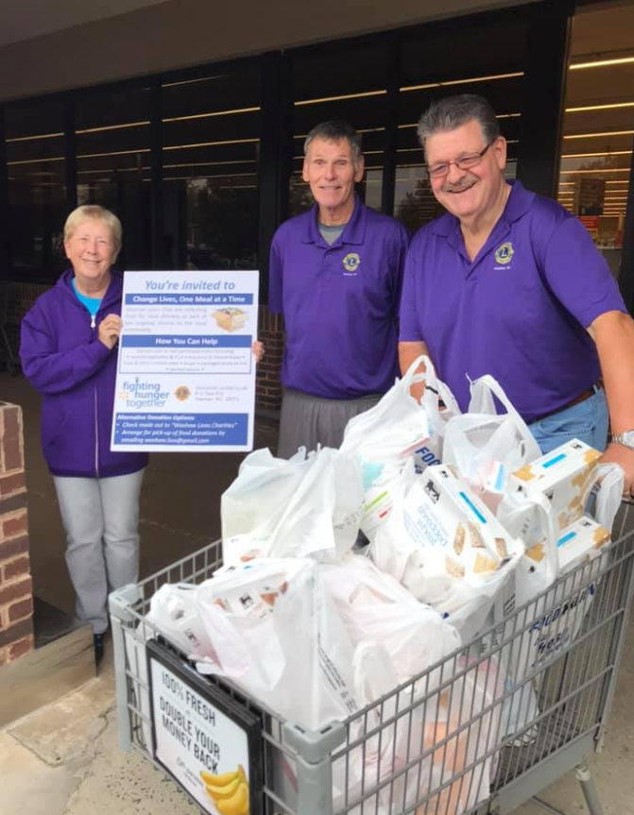
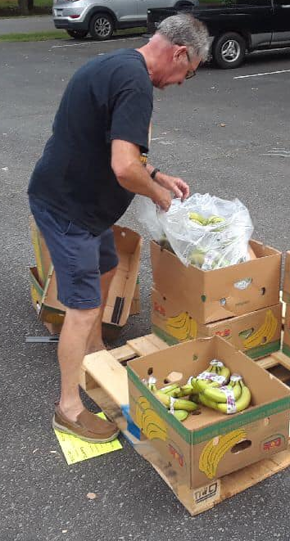
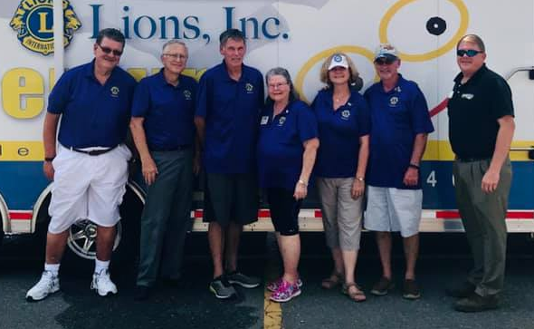
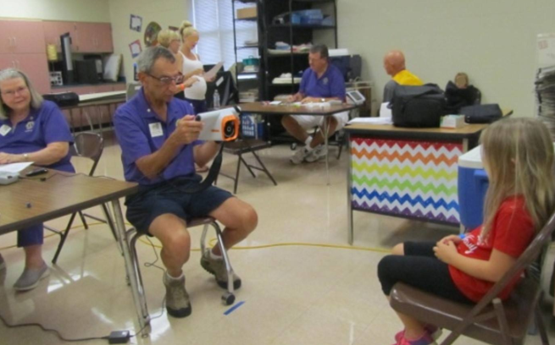
Lions Clubs Serve
Notes:
Add clubs name and photos

Slide 31
State Projects of the Michigan Lions
Lions of Michigan Foundation
Notes:
Trainer Tip: Consider adding additional information about these projects.

Slide 32
Meetings – Example Agenda
Note: Personalize these items to suit your club
Meeting date, time, and location
Call to Order
Invocation
Pledge to Flag
Singing of National Anthem (optional)
Introduction of Guests (list by rank/title, guests)
Tailtwister
Business (Secretary Report, Treasurer Report, Minutes, Communications, Committee Reports, New Business)
Guest speaker or Program
Adjournment
Notes:
Trainer Tip: Edit this slide as you see fit. Remove things that don’t apply to your club, or add things that are not currently included.

Slide 33
Club History
Note: Personalize these items to suit your club
Charter date
Club sponsor
Club mission statement
Club goals
Club projects
Major accomplishments
Notes:
Trainer Tip: Edit this slide as you see fit. Remove things that don’t apply to your club, or add things that are not currently included.

Slide 34
Club Officers
President Chief executive officer of the club. Call and preside over meetings, call elections, cooperate with and provide status reports to the zone chair.
Vice Presidents Perform duties of President as-needed. Oversee club committees. Serve as leadership chair.
Secretary Submit reports to LCI and district, maintain club records, and issue financial statements.
Treasurer Receive all money for club, pay club obligations, maintain financial records, and prepare financial statements.

Slide 35
Club Officers
Lion Tamer Responsible for the property of the club (flags, banners, gavel, etc.), assure that new members get acquainted with older members.
Tail Twister Promote harmony, good fellowship, attendance, and enthusiasm in the meetings through stunts, games and the judicious imposition of fines on club members.
Membership Director Develop a growth program for the club, encourage recruitment and retention procedures, and prepare orientation sessions.

Slide 36
Lions Club Service Activities
Note: Personalize these items to suit your club
Participate in District service opportunities
Coordinate activities within the club
Partner with other clubs and organizations
Examples:
Schedule and Perform KidSight Vision Screening (Children)
Provide Glasses, Eye and Hearing Exams, Financial Aid
Collect Used Eyeglasses and Hearing Aids
Hold a Food Drive
Plan a Golf Outing or other Fundraiser
Notes:
Trainer Tip: Consider adding photos from the projects to the slide if they are available.

Slide 37
How We Communicate
Communication should be flexible enough to reach all Lions and community members.
Formats include:
Email, phone, text, Facebook, Instagram, websites, newspaper, newsletter, billboards, radio, etc

Slide 38
Recognition and Awards
Awards can be presented to clubs, districts, individual Lions, and community members.
Awards are given through LCI, LCIF, clubs, districts, multiple districts, Lions of Michigan Foundation, Eversight, and other Lions organizations.

Slide 39
Recognition and Awards
Distinguished Service – LCI
Ambassador of Goodwill
International President’s Award
International President’s Leadership Medal
International President’s Recognition Award
Notes:
(1) Ambassador of Goodwill
The Ambassador Award is generally awarded to high level Lions for their many years of service. There are only a maximum of 35 awarded each year and is the highest award from LCI.
(2) International President’s Award
Awarded for outstanding service by a Lion to the causes or activities Lions are active in. Nominated by a District Governor. There are a very limited number awarded each year and is the 2nd highest award from LCI.
(3) International President’s Leadership Medal
Awarded for outstanding leadership by a Lion on Lions issues or service issues. Nominated by a District Governor. There are a limited number awarded each year and in each State and is the 3rd highest award from LCI.
(4) International President’s Recognition Award
Awarded in recognition of distinguished achievements in fulfilling the service mission of Lions Clubs. Nominated by a District Governor and usually awarded personally by an International Director. It is the 4th highest award from LCI.

Slide 40
Recognition and Awards
Additional Awards – LCI
100% District Governor President’s Award
100% Club Excellence Award
Extension Award (starting a new Lions Club)
Guiding Lion Award (supporting a new Lions Club)
Member Key Award (sponsoring a new member)
Notes:
100% District Governor
Honors club presidents who furthered and promoted the district governor's goals for the current year, the objectives of LCI, adhered to the LCI constitution and by-laws, no unpaid dues, accomplished a net growth in membership or sponsored a new Lions club, club officers have attended officer training, and attended conventions, forums, zone meetings, and cabinet meetings.
100% Club Excellence Award
Honors clubs that excel in community service, membership growth, communication and organizational management may qualify for the prestigious Excellence Awards. Clubs receive a distinguished banner patch to proudly display on their banner and the club president receives a Club Excellence Pin to proudly recognize his or her outstanding leadership. The general criteria for the award includes good standing with International, Melvin Jones contributions, membership growth, excellent communication, leadership development, and club development. Please use the qualifications outlined in the club or district application as your road map to excellence.

Slide 41
Recognition and Awards
Distinguished Service – LCIF
Melvin Jones Fellowship
The Melvin Jones Fellowship is the highest award of the Lions Club International Foundation (LCIF).
It is presented in recognition of humanitarian work.
Clubs and individuals earn the right to present this award through their donations to LCIF.
Notes:
Melvin Jones Fellowship
The Melvin Jones Fellowship (MJF) is LCIF's highest honor, and is a recognition of humanitarian work and is presented in honor of donations made to LCIF of $1,000. Often these donations are made by a group or district on behalf of an honoree.
Created in 1973, the fellowship is named for the founder of Lions Clubs International, Melvin Jones. The fellowship represents humanitarian qualities such as generosity, compassion, and concern for the less fortunate. Melvin Jones Fellows receive a lapel pin and a personalized wall plaque in honor of their commitment to helping others.

Slide 42
Recognition and Awards
Distinguished Service – MD-11
S.A Dodge Distinguished Service Award
Honoring lifetime achievement at all levels of Lions
Notes:
S.A Dodge Distinguished Service Award
The S.A. Dodge Award is presented to two Lions each year at the MD11 State Convention. The award is for distinguished service at the district, state, and international levels of the Lions organization. Honoring lifetime achievement.

Slide 43
Recognition and Awards
Lions of Michigan Foundation Awards
John S. Noel Fellow
Helen Keller Fellow
Ken Lautzenheiser Fellow
Lions of Michigan Hall of Fame
Eversight Awards
William (Doc) Barr – Knight for Vision Fellowship
A. Charles Weir – Sight Conservation Fellowship
Notes:
John S. Noel Fellow
The John S. Noel Fellow is the Lions of Michigan Foundation’s most distinguished form of recognition, and the award is available to recognize an outstanding individual for his or her service to Lions and those in need. The award is available for contributions of $1,000 or more to the Lions of Michigan Foundation.
John S. Noel was a charter member of the Grand Rapids Lions Club in 1919, and he was Michigan’s 1st President of Lions Clubs International in 1923-24. The award is duly named in honor of John S. Noel's accomplishments in advancing the cause of Lionism in Michigan and throughout the world and for his tireless efforts to help people in need.
Hellen Keller Fellow
The Hellen Keller Fellowship award is available to recognize those that have contributed to issues that relate to sight, hearing and disabilities. The award is available for contributions of $750 or more to the Lions of Michigan Foundation. Hellen Keller challenged the Lions in 1925 to "Become Knight of the Blind" that shaped Lions to support Sight and Hearing issues since then.
Ken Lautzenheiser Fellow
The Ken E. Lautzenheiser Fellow is available for contributions of $500 or more to the Lions of Michigan Foundation. The award is often used to recognize extraordinary efforts by a Lion or Lioness Club member -
many Clubs and Districts use the award to recognize the Lion and/or Lioness of the year. Ken E. Lautzenheiser was instrumental in organizing the Lions of Michigan Foundation in the early 1980's. He believed there was a definite need in Michigan for an organization that could address the medical needs of individuals that had no insurance and nowhere else to turn. Ken knew that if Lions Clubs combined resources, Lions could have a greater impact on their communities and do more to help people in need.
Lions of Michigan Hall of Fame
The Lions of Michigan Hall of Fame is a project of the Lions of Michigan Foundation. The purpose is to recognize and honor those individuals who have had a significant impact on Lionism in Michigan and to preserve a memory and record of their service. Each year up to four individuals are selected for enshrinement, normally one living member and up to three deceased individuals
Lions of Michigan Humanitarian Award
(need to add details)
William (Doc) Barr – Knight for Vision Fellowship
William “Doc” Barr has shared his diverse knowledge, experience and passion for helping others as
an Eversight board member for more than 20 years. His commitment to service is also reflected in
his dedication to the Lions. Doc first joined the Sparlingville Lions Club in 1956, followed by the
Highland Park and Novi Lions Clubs.
The William “Doc” Barr Knights for Vision Fellowship is in recognition of humanitarian work and
awarded to those who donate $1,000 or more to Eversight in a three-year period. Knights for Vision
Fellows receive an engraved crystal desktop pedestal, attractive gold lapel pin, a certificate and a
congratulatory letter.
A. Charles Weir – Sight Conservation Fellowship
A longtime Eversight ambassador, A. Charles Weir was a respected and beloved leader among the
Eversight Board of Directors for decades. A retired educator, Weir spent 34 years as a teacher and
administrator for vision-impaired children at the Michigan School for the Blind. An active member of
the Bretton Woods Lions Club, Weir held many offices, including Club President, District Governor and
Council Chair for District 11-C2.
The A. Charles Weir Sight Conservation Fellowship is in recognition of humanitarian work and awarded
to those who donate $500 or more to Eversight in a three-year period. Sight Conservation Fellows
receive an engraved crystal desktop pedestal, attractive silver lapel pin, a certificate and a
congratulatory letter.

Slide 44
Recognition and Awards
Distinguished Service – District 11-B1
Wendell Doty Award – Highest Award
Individual Awards
District Lion/Lioness Award
District/Region/Zone
District Leo Award
Governor’s Award – Individual Involvement in District
Notes:
Wendell Doty Award – Highest Award
(need to add details)
District Lion/Lioness Award
(need to add details)
District/Region/Zone
(need to add details)
District Leo Award
(need to add details)
Governor’s Award – Individual Involvement in District
(need to add details)

Slide 45
Recognition and Awards
Membership – District 11-B1
PDG Paul Frederick Spark Plug Award
Highest Net Gain in Membership
PDG Dave Hill Outstanding Membership Gain Award
Highest Total Number of Members Gained
Notes:
The PDG Paul Frederick Spark Plug Award is given to the club with the greatest percent increase in membership. An example would be if there are 10 members in a club at the beginning of the year and at the end of the Lion year they have 15 members they had a net gain of 5 members but a 50% gain in membership.
The PDG Dave Hill OMG (Outstanding Membership Growth) Award is given to the club that adds the most members in a Lion year. An example would be if a club started the Lion year with 50 members and ended the Lion year with 65 members they would have a net gain of 15 members. The club with the greatest net gain of members gets the OMG Award.

Slide 46
Welcome to Lions Clubs!
Any Questions?

