Slide 1
Before you begin.
This presentation should be viewed as a
PowerPoint Slide Show
To view as a slide show:
1. Click on ‘Slide Show’ from the menu at the top of the screen.
2. Select ‘From Beginning’
For additional assistance, contact your club’s Information Technology Chairperson or Electronic Learning at: eLearning@lionsclubs.org

Slide 2
Click here if you need to access and print your workbook before continuing.
Click arrow to advance slide.

Slide 3
As you read in module 1, the zone chairperson maintains several positions simultaneously.
This module will focus on the role of zone chairperson as the administrative officer of the zone.
At the end of this module, you will be able to:
Understand the obligations and objective of the zone chairperson at the club level
Evaluate the best way to support clubs in the zone
Click arrow to advance slide.

Slide 4
Zone Chairperson Self-Guided Training
Module 2:
Zone Chairperson as the
Administrative Officer of the Zone
Turn to page 1 in your workbook.
Click arrow to advance slide.

Slide 5
As zone chairperson, you are the administrative officer of the zone.
Zone Chairperson
Club
Club
Club
Club
Your objective is to maintain healthy and active clubs in the zone.
Click arrow to advance slide.

Slide 6
To help you achieve this objective, you will need to ensure that clubs in the zone:
Understand their position and importance in the association
Function within the framework of the association’s constitution and policies
Feel an integral part of the district
Strive for excellence and continuous growth
Constitutional Areas
Single and Multiple Districts
Zones and Regions
Clubs
Complete page 1 in your workbook.
Click arrow to advance slide.

Slide 7
Healthy Clubs
Click arrow to advance slide.

Slide 8
Characteristics of a Healthy Club
What do you believe are characteristics of a healthy club?
Write your answers on page 2 of your workbook.
Once you are ready, advance the slide to view some of the characteristics on our list.
Click arrow to advance slide.

Slide 9
Characteristics of a healthy club
Meets on a regular basis
Maintains continuous membership growth
Engages its members in activities that are meaningful to them
Sponsors numerous service projects which meet the needs of the community
Involves and encourages members’ interest in leadership development
Conducts successful fund-raising projects
Pays its dues and submits monthly reports on a timely basis
Compare these characteristics to your notes on page 2 of the workbook.
Click arrow to advance slide.

Slide 10
Tools to Determine the Health of Clubs
There are many resources available to the zone chairperson. We will highlight several of them for you.
Turn to page 3 in your workbook.
Click arrow to advance slide.

Slide 11
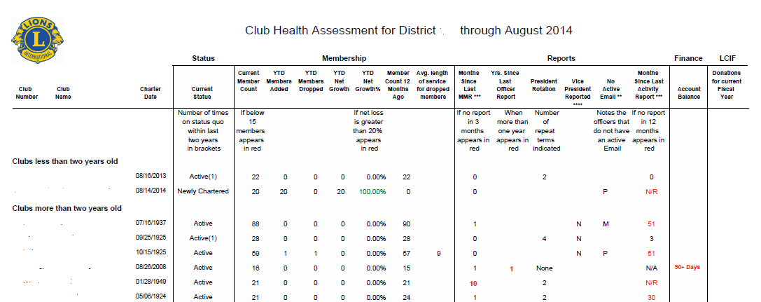
Club Health Assessment
Below is a sample of an actual Club Health Assessment. This report allows the zone chairperson a quick reference to data that helps determine the health of a club.
Club Name A
Club Name B
Club Name C
Club Name D
Club Name E
Club Name F
Club Name G
Club Name H
Click arrow to advance slide.

Slide 12
Club Health Assessment
The information available includes:
The status of the clubs
Year to date added and dropped members
Account balance and LCIF donations for the current fiscal year
Current member count
Months since last MMR reporting or activity reporting
Club Name A
Club Name B
Club Name C
Club Name D
Club Name E
Club Name F
Club Name G
Club Name H
Click arrow to advance slide.

Slide 13
Membership Satisfaction
The Membership Satisfaction Guide and “How are your Ratings?” allow members to provide feedback on various facets of the membership experience, such as:
The quality of club meetings
The frequency and organization of service activities
Preferred service activities
The demographics of the club
Members’ social experience within the club
Areas of frustration
Click arrow to advance slide.

Slide 14
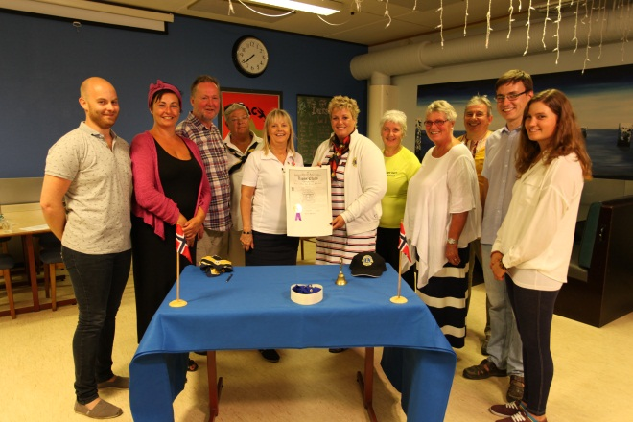
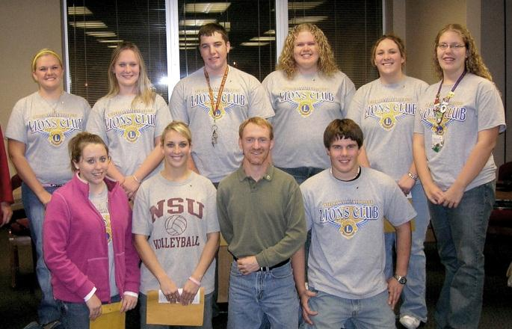
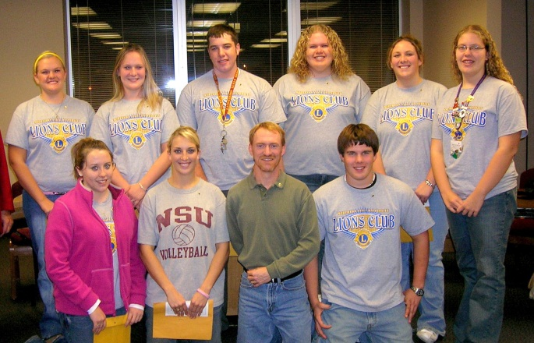
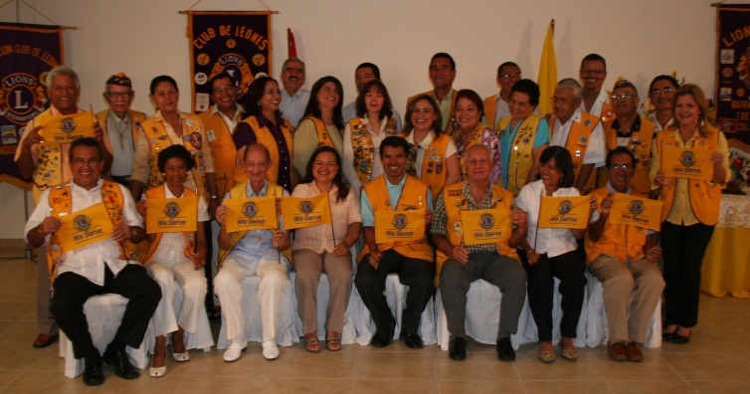
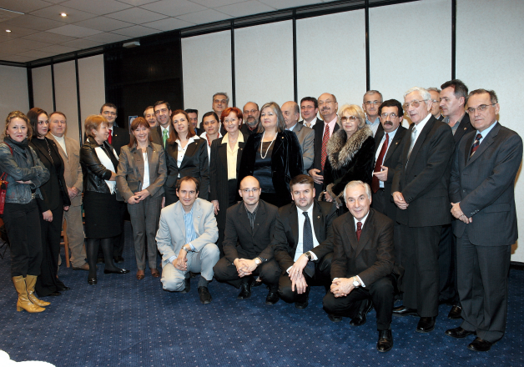
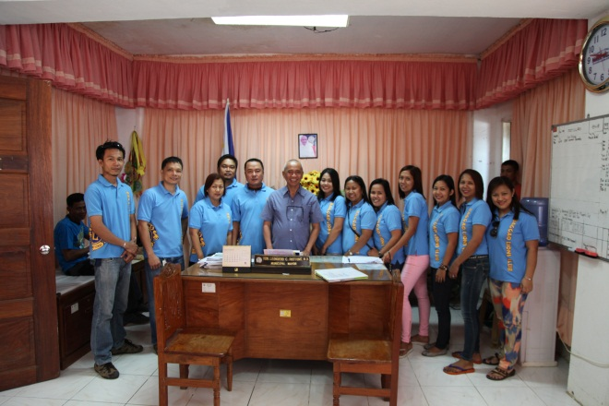
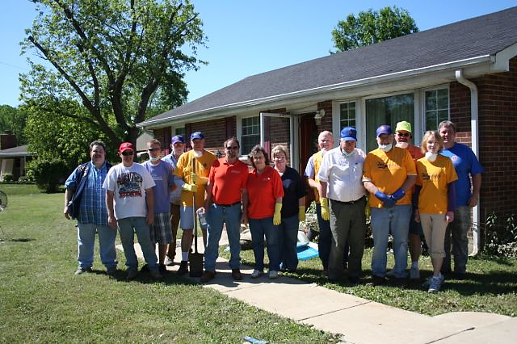
Club Visits
As zone chairperson, you are expected to visit clubs in the zone more than once annually.
Club visits provide an opportunity for the zone chairperson to:
Build a rapport with the members of the club
Make a personal observation on the well-being of a club
Provide support and recognition to the club and its members
Promote zone and district goals
Maintain effective communication
Turn to page 4 in your workbook.
Click arrow to advance slide.

Slide 15
Blueprint for a Stronger Club
The Blueprint for a Stronger Club provides a step by step process to aid in:
Assessing a club
Identifying goals and challenges
Creating an action plan
Click arrow to advance slide.

Slide 16
District Governor’s Advisory Committee
The District Governor’s Advisory Committee meets three times annually.
The advisory committee meetings provide an opportunity for the zone chairperson to collaborate with the presidents and secretaries of the clubs in the zone.
This gives committee members a forum to exchange ideas, give and receive feedback and coordinate zone goals and initiatives.
The District Governor’s Advisory Committee will be discussed further in module 3.
Click arrow to advance slide.

Slide 17
Remember…
Your objective as the zone chairperson is to maintain healthy and active clubs in the zone.
Once you understand the health of a club, you are able to provide support based on the needs of the club.
There are several tools you can access or refer to members.
Click arrow to advance slide.

Slide 18
Training and Support Resources
Turn to page 5 in your workbook.
Click arrow to advance slide.

Slide 19
The Zone and Region Chairperson Center provides links to helpful tools for membership growth and club development as well as specific programs for zone chairpersons.
The Lions Learning Center offers courses on topics to help develop leadership skills. These include effective meetings, providing innovative community service, conflict resolution and coaching, to name a few.
Leadership Resource Center has additional training materials, such as club officer orientation, presentations for speaking engagements and the leadership webinar series.
Click arrow to advance slide.

Slide 20
The Lions membership center provides a variety of tools that focus on:
New Members
New Clubs
Inviting Members
Strengthening Membership
Click arrow to advance slide.

Slide 21
The Serve! center offers a variety of ideas that focus on:
Centennial Service Challenge
Sight
Environment
Children and Youth
Diabetes
Literacy
Hearing
Disaster Relief
Community Outreach
Global Outreach
The GMT-D and GLT-D are also available to provide clubs and the District Governor’s Advisory Committee additional assistance.
Click arrow to advance slide.

Slide 22
3 Scenarios
What would you do?
Turn to page 7 in your workbook.
Click arrow to advance slide.

Slide 23
It is time to use the information you have learned to evaluate a few typical club situations.
To follow are 3 different scenarios with leading questions.
Document ways you can provide assistance to the club in each of the scenarios.
There is no one correct answer so we will also provide a number of ideas that you can note in the space provided in your workbook.
Click arrow to advance slide.

Slide 24
Scenario 1
There is a club in your zone that meets regularly but the members do not feel connected to the district or association.
What questions would you as zone chairperson ask to learn more about the situation?
Who might you involve from the club, zone, district?
How might you help alleviate the situation?
What tools or resources would you use or suggest to the club?
Write your responses on page 7 of your workbook.
Click the arrow when you are ready to compare your ideas.
Click arrow to advance slide.

Slide 25
Scenario 1
There is a club in your zone that meets regularly but the members do not feel connected to the district or association.
Ask members what would make them feel more connected.
Suggest club Program Committee chairperson reach out to other clubs in the zone to partner on zone-wide service project
Create a zone-wide newsletter to disseminate information about district initiatives and events within the zone
Encourage attendance at zone, region, district and multiple district events
Recognize the activities of the club during your club visits and in zone communications
Create an e-clubhouse page for the zone
Click arrow to advance slide.

Slide 26
Scenario 2
There is a club in your zone that has been placed on status quo because they have not reported service projects for quite some time.
What questions would you as zone chairperson ask to learn more about the situation?
Who might you involve from the club, zone, district?
How might you help alleviate the situation?
What tools or resources would you use or suggest to the club?
Write your responses on page 8 of your workbook.
Click the arrow when you are ready to compare your ideas.
Click arrow to advance slide.

Slide 27
Scenario 2
There is a club in your zone that has been placed on status quo because they have not reported service projects for quite some time.
Determine if the club is conducting service projects and, if not, inquire the reason why
Provide guidance to the club officers as to the association’s reporting policy and verify if additional training is required
Encourage members to take the Providing Community Service course offered on the Lions Learning Center
Prompt service project ideas from all members
Work with club officers and members of the district leadership team to set goals to bring the club – and keep the club – out of status quo
Click arrow to advance slide.

Slide 28
Scenario 3
You find a club that is holding regular meetings and conducting service projects, yet is not maintaining steady membership.
What questions would you as zone chairperson ask to learn more about the situation?
Who might you involve from the club, zone, district?
How might you help alleviate the situation?
What tools or resources would you use or suggest to the club?
Write your responses on page 9 of your workbook.
Click the arrow when you are ready to compare your ideas.
Click arrow to advance slide.

Slide 29
Scenario 3
You find a club that is holding regular meetings and conducting service projects, yet is not maintaining steady membership.
Has a membership satisfaction survey been conducted to determine the reasons why members left the organization?
Encourage club leadership to take the Member Motivation course available on the Lions Learning Center.
Communicate your concerns with the district governor team and the GMT, who can assist with creating and implementing a membership satisfaction plan.
Click arrow to advance slide.

Slide 30
How did you do?
Clubs face a variety of challenges. These challenges will be easier for clubs to overcome when supported by their zone and district.
As zone chairperson, you are the link between clubs in the zone and the supportive programs and leaders in the district.
Click arrow to advance slide.

Slide 31
Quick Check
Are you ready to take on your responsibilities?
Review the questions on page 10 of the workbook.
If you are not able to answer affirmatively, make time in your schedule to complete suggested skill development.
Click arrow to advance slide.

Slide 32
Module Summary
An effective zone chairperson will be very familiar with the clubs in the zone. Understanding the health of the clubs, the service activities they are conducting, member satisfaction, and each club’s strengths and challenges, will allow the zone chairperson to effectively manage the health of the clubs in the zone.
Click arrow to advance slide.

Slide 33
Module Summary
In addition to club visits, the zone chairperson has several tools available which help assess the health of clubs in the zone.
Furthermore, there are many resources available to the zone chairperson, club leadership and club members, that can help promote member satisfaction and leadership development.
Click arrow to advance slide.

Slide 34
This concludes module 2: Zone Chairperson as the Administrative Officer of the Zone
Have we met our objectives?
Examined the obligations and objective of the zone chairperson at the club level
Evaluated the many ways to support clubs in the zone
Click arrow to advance slide.

Slide 35
Thank you for your participation.
Please complete the following modules to learn more.
Module 1: Roles and Responsibilities Overview
Module 3: Zone Chairperson and the District Governor’s Advisory Committee
Module 4: Zone Chairperson as Member of the District Cabinet
If you have any questions, please contact:
eLearning@Lionsclubs.org
Click arrow to advance slide.

