Slide 1
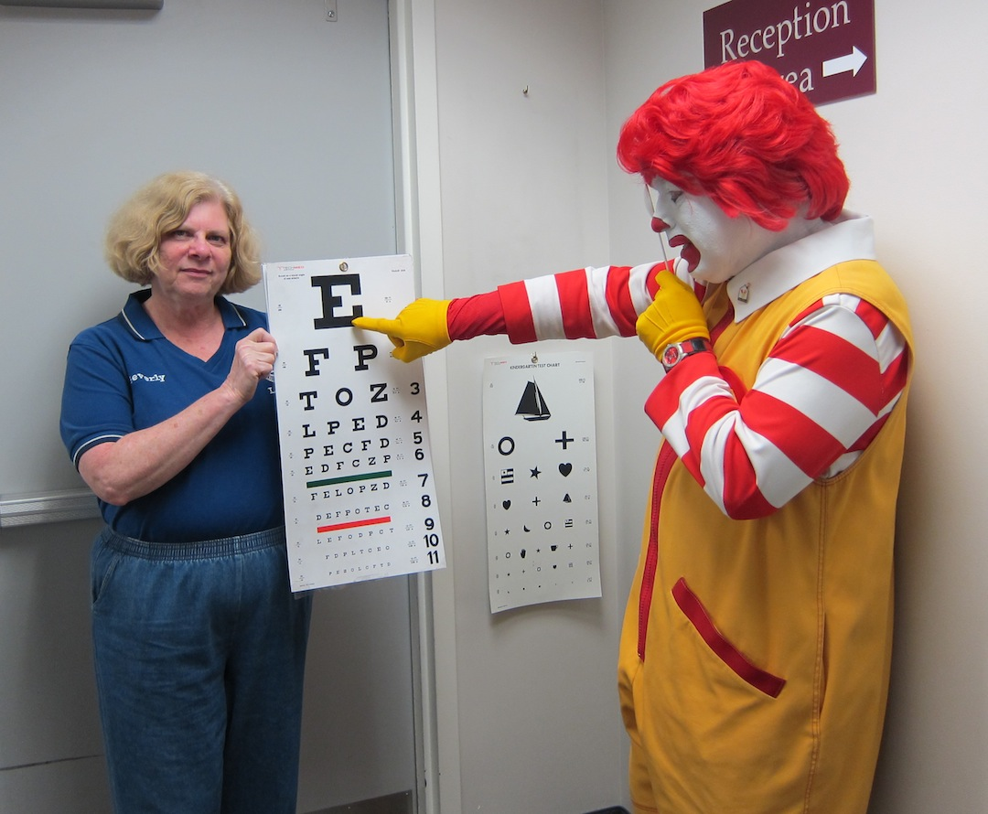
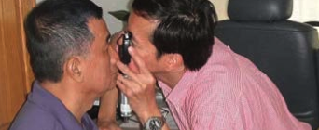
The Heart of Lionism WE SERVE
Orientation of New Members
District 4-L4

Slide 2
The Heart of Lionism WE SERVE
District 4-L4 Orientation of New Members
For further information and updates to this presentation, contact:
Gil Smith
District 4-L4 Governor
Gilfsmith@aol.com
H: 909-860-6477 C: 909-802-9915

Slide 3
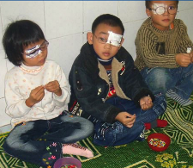
Lions are men and women dedicated to help those in need, wherever need exists.

Slide 4
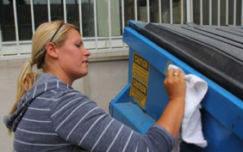
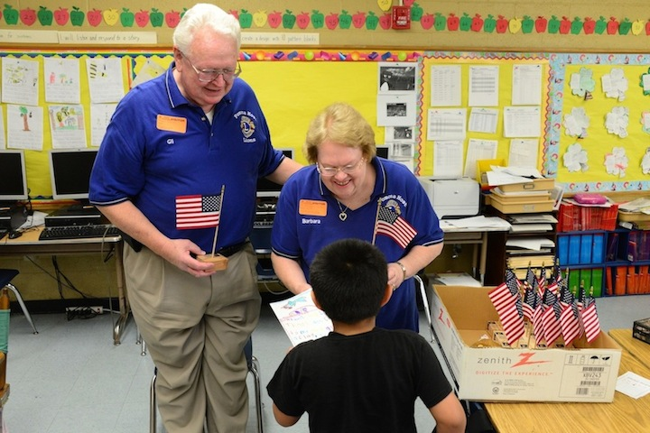
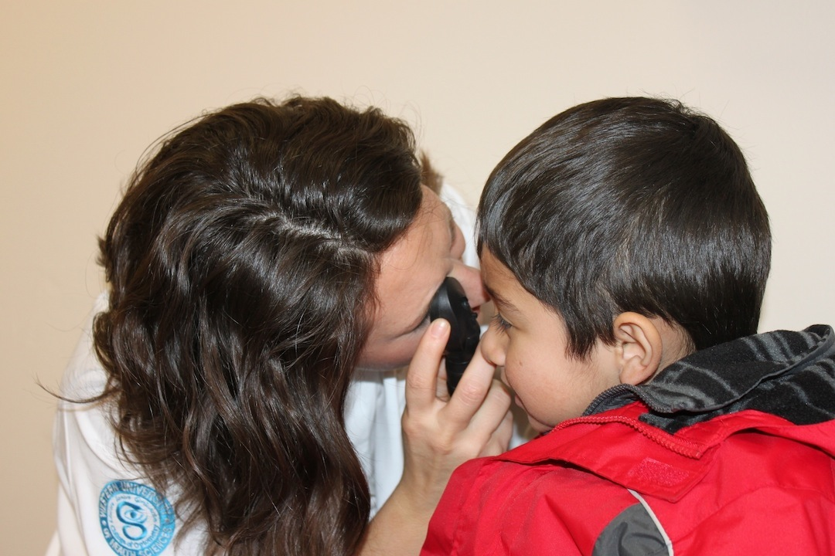
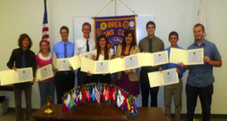
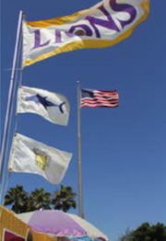
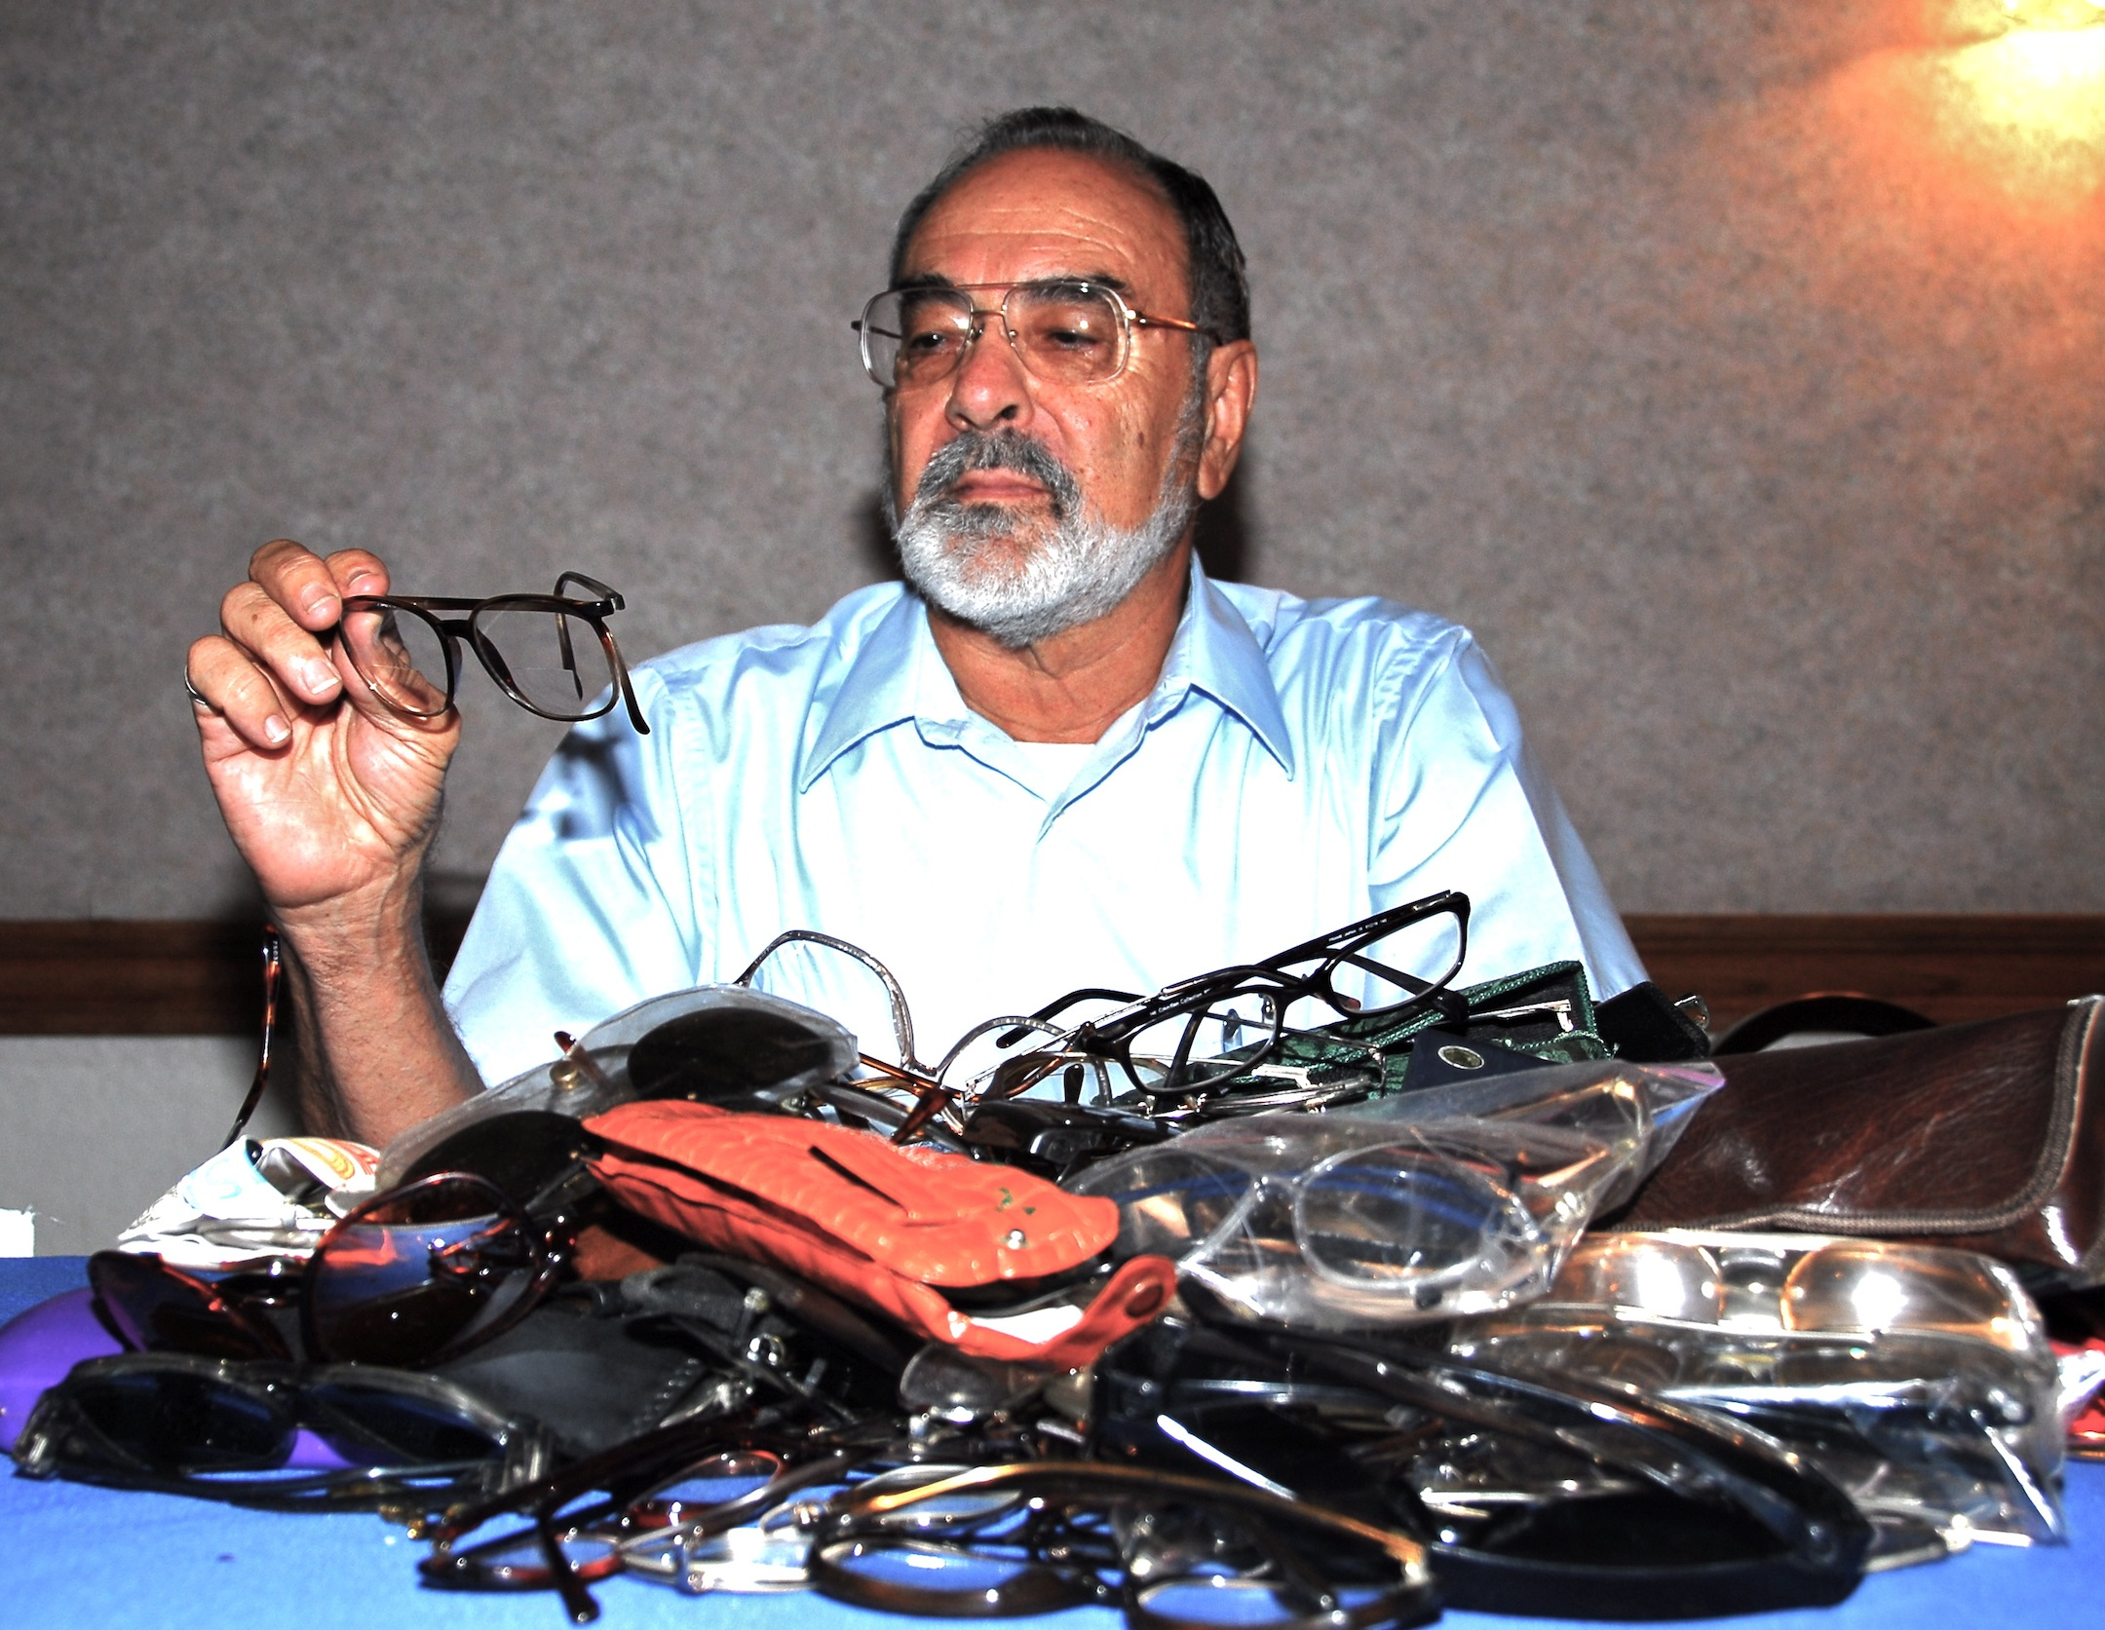
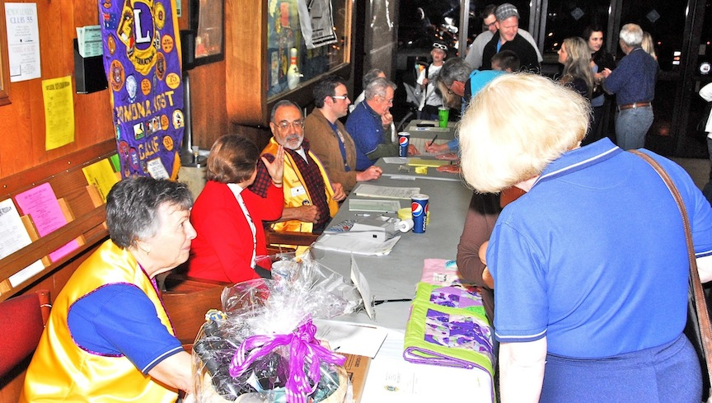
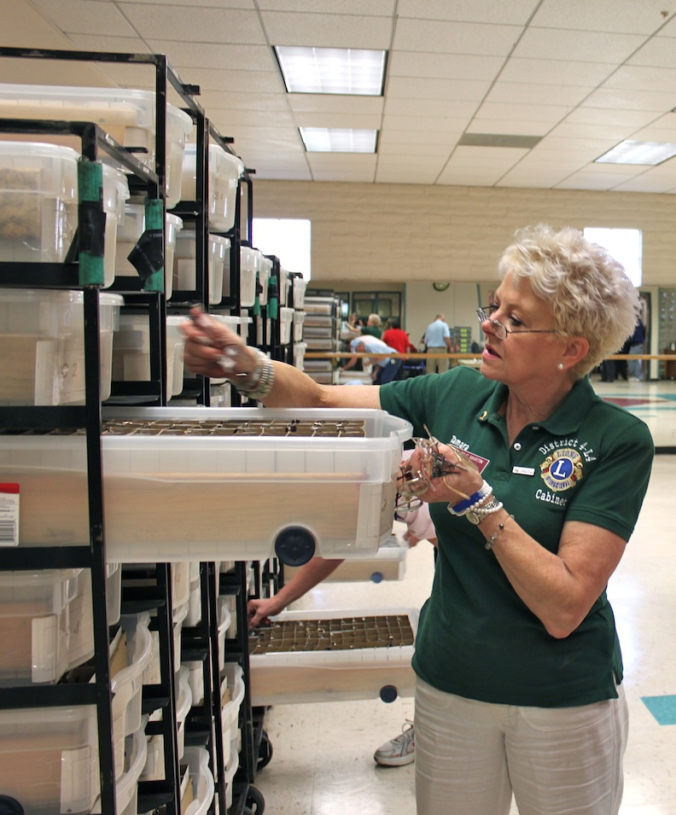
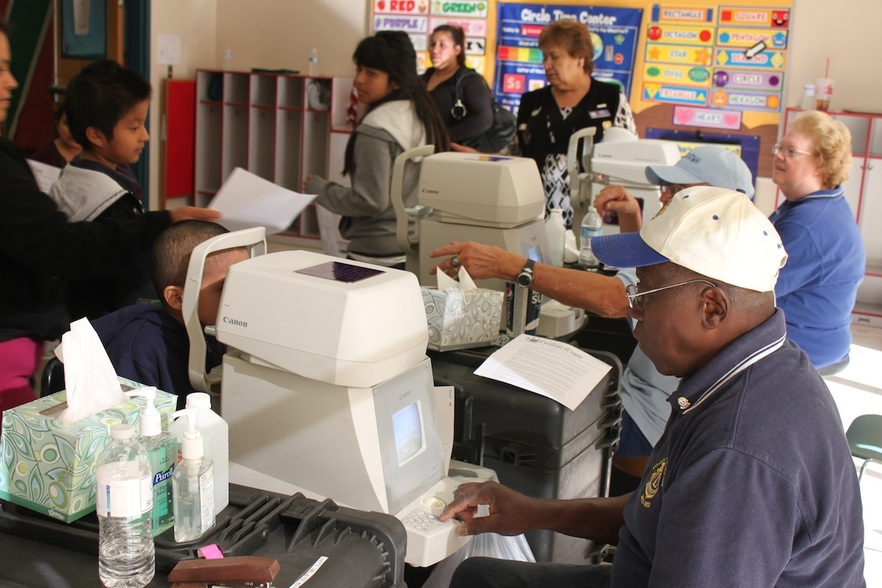

Slide 5
SERVING OTHERS CREATES THAT SPECIAL LIONS FEELING.

Slide 6
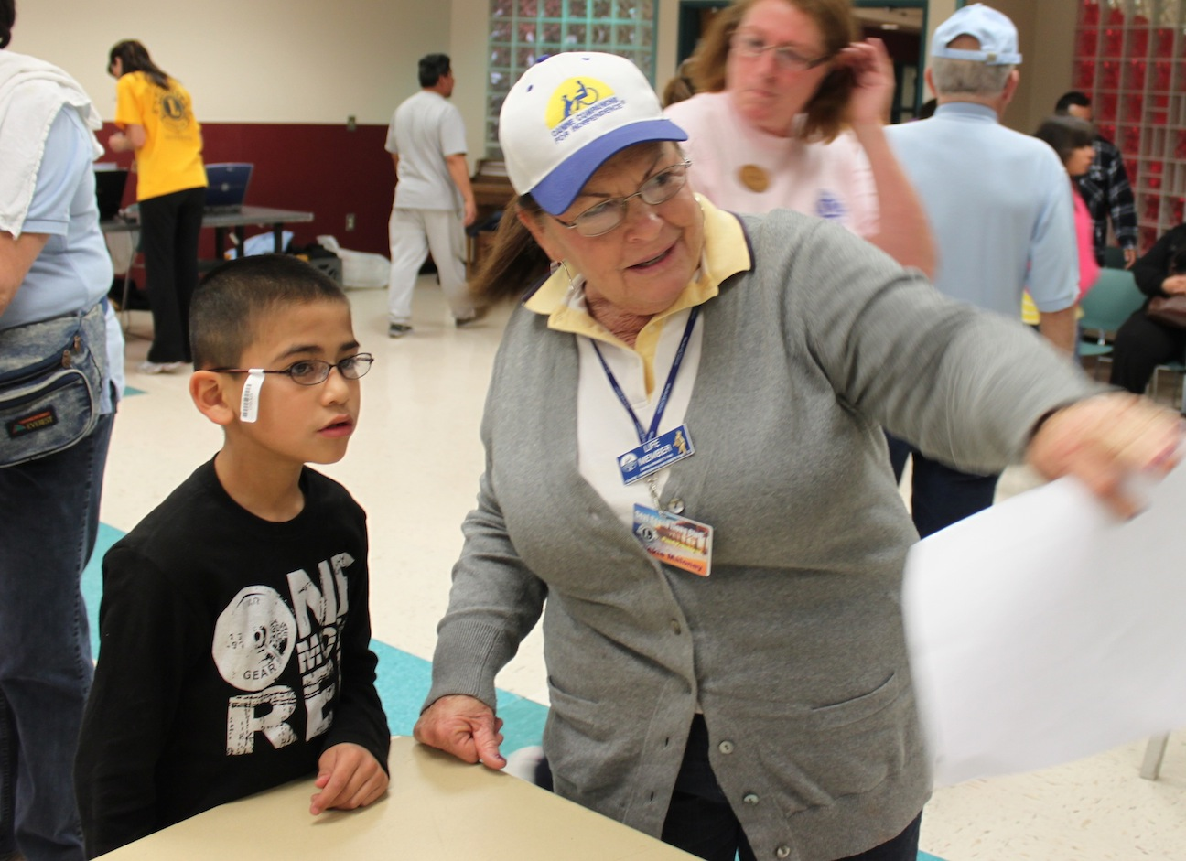
THE SPECIAL LIONS MOMENT
The more we help others, the more we glow from within.
The lump-in-the throat, spine-tingling, misty eyes moments
The realization that
we have truly made a
difference, that we have
touched people’s lives

Slide 7
LIONS MOTTO
“We Serve”
VISION STATEMENT
To be the global leader in community and humanitarian service

Slide 8
MISSION STATEMENT
To empower volunteers to serve their communities, meet humanitarian needs, encourage peace and promote international understanding through Lions clubs
Expanded details can be seen online under Lions Clubs International Purposes.

Slide 9
Lions Code of Ethics
Condensed Version--Full Version is online.
Work hard, believe in what I do, and earn respect.
Work for success and profit, but never lose self-respect or take unfair advantage of others.
In building up my business and myself, never tear down others. Be loyal to others and true to myself.
Resolve disagreements with others.

Slide 10
Lions Code of Ethics continued Condensed Version--Full Version is online.
Hold friendship as an end, not a means.
Be a loyal citizen, and give freely to my community, state and nation.
Help those who are needy.
Be careful with my criticism and liberal with my praise; to build up and not destroy.

Slide 11
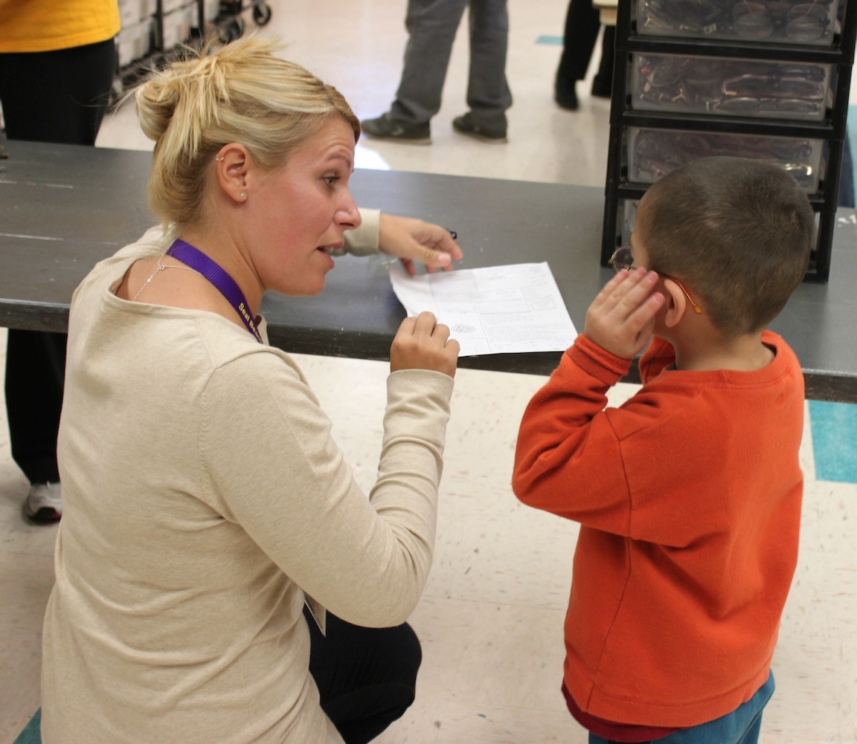
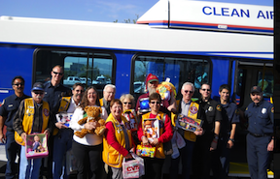
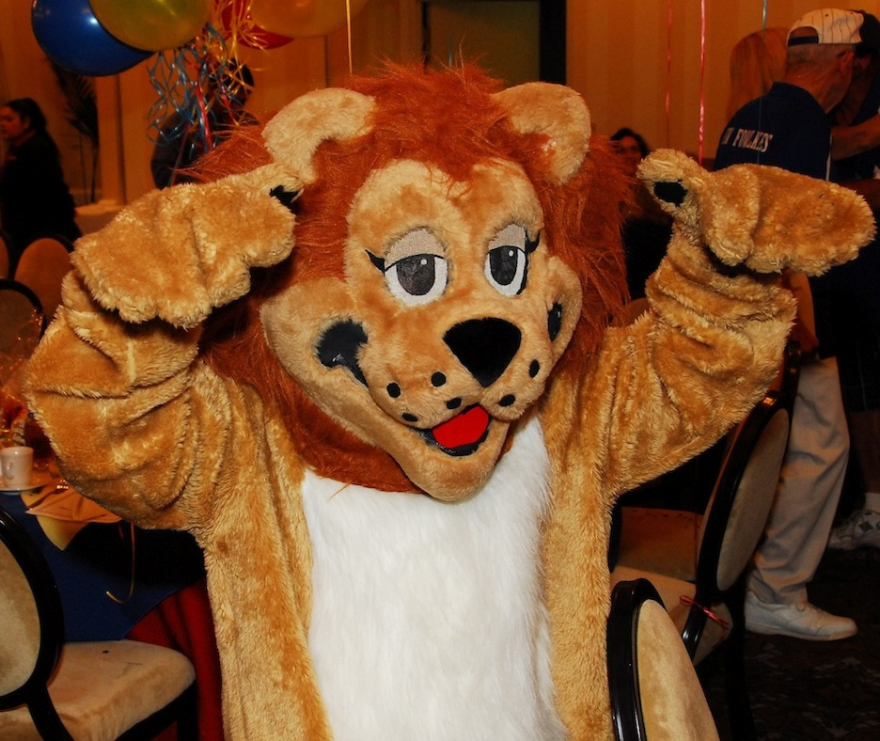
In Lions You Will…
• Help your community.
• Make an impact on people’s lives.
• Learn to be a leader.
• Network.
• Energize and have fun!

Slide 12
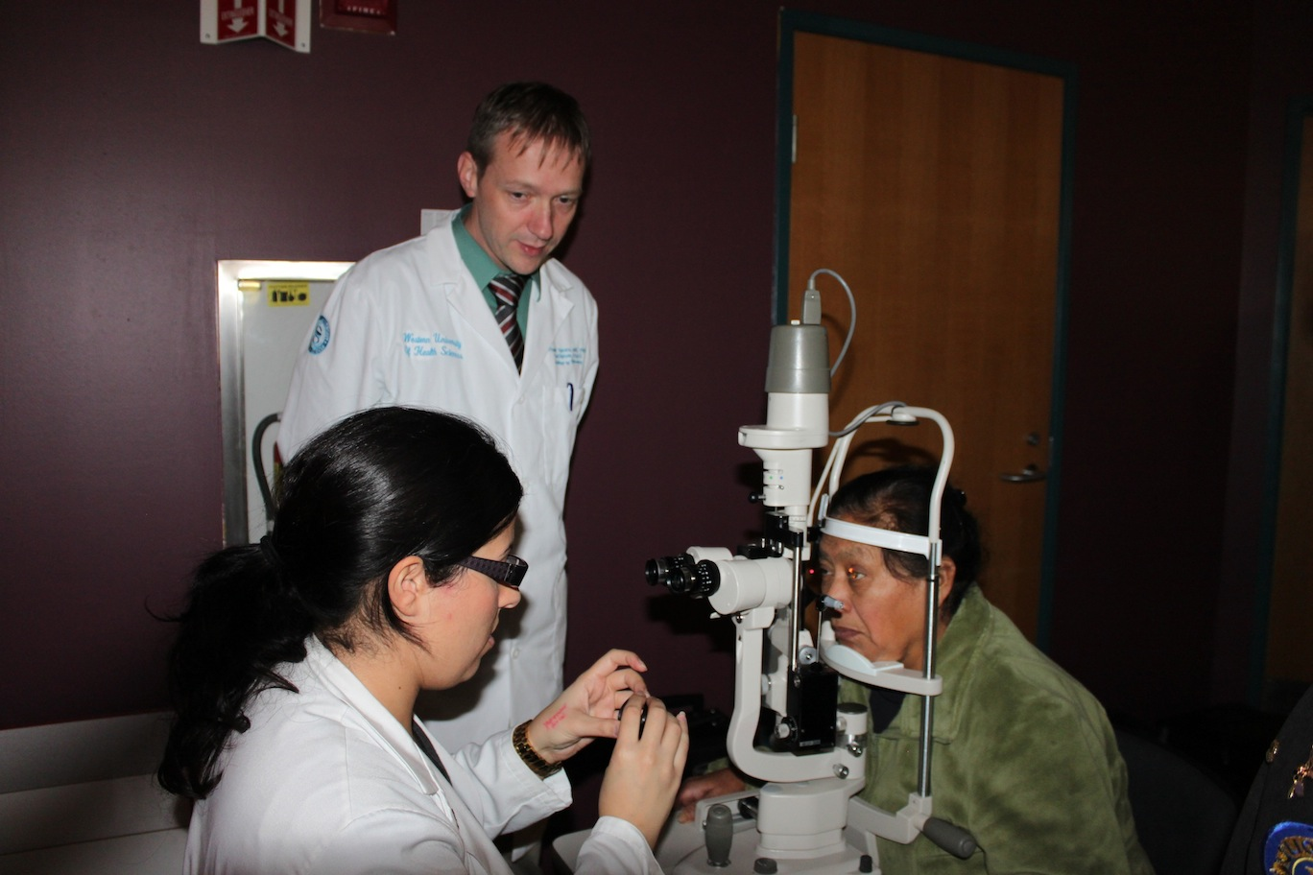
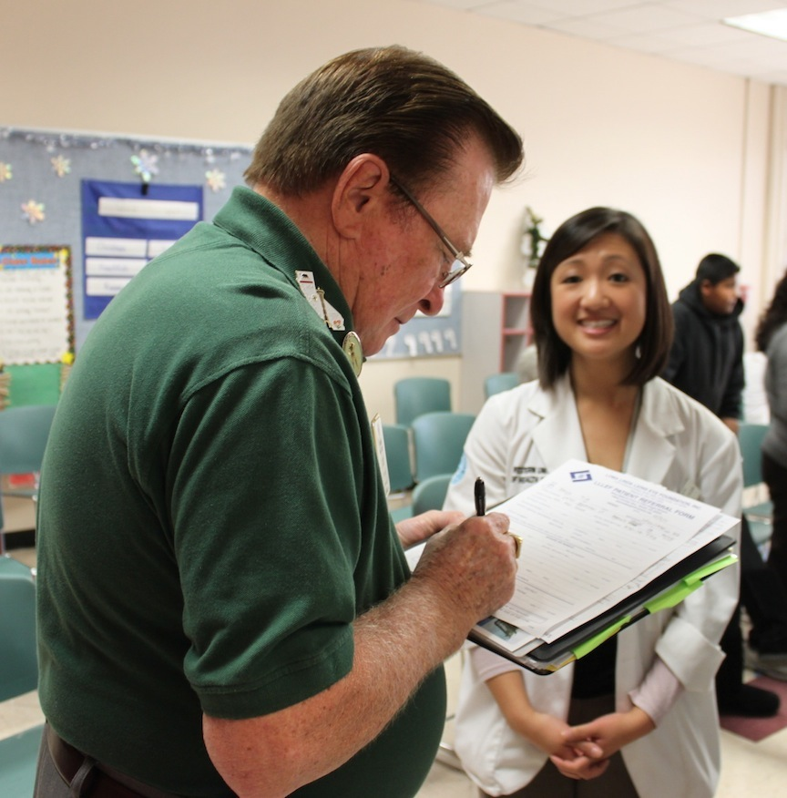
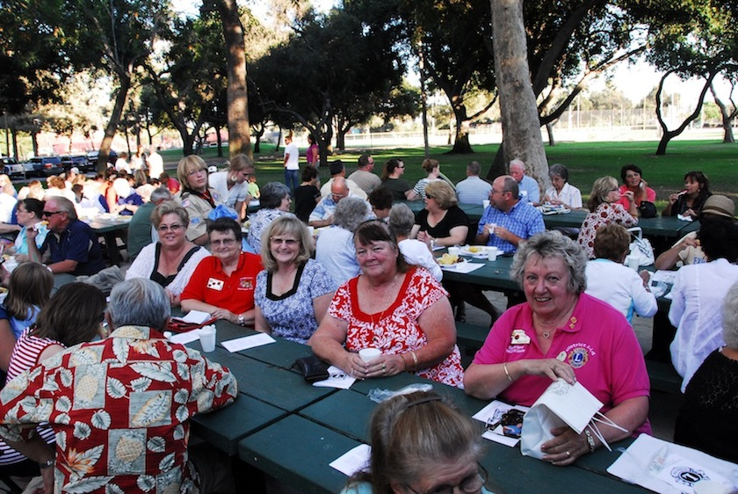
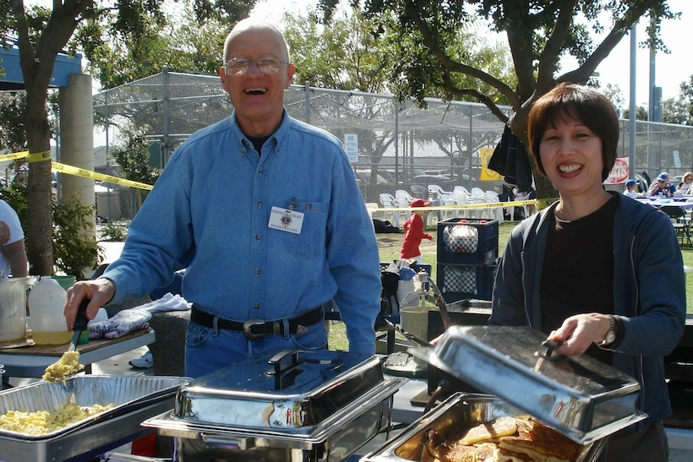
2 Approaches to Service
Hands-on for Service
Fundraising for Service

Slide 13
LCI Service Areas
Community Service
Hands-on Service to the Community
Cultural and Community Activities
Disaster Preparedness and Relief
Catastrophic Disaster Relief
Lions Alert (Preparedness)
Environmental Services
Lions Green Team
Lions Environmental Photo Contest

Slide 14
LCI Service Areas continued
4. Health and Wellness
Sight Awareness and Action
Original and most prevalent
service area
Diabetes Awareness and Action
Hearing Awareness and Action

Slide 15
LCI 7 Service Areas continued
5. Youth: Opportunities and
Services
Leo Clubs Program
Lions Children First
International Peace Poster Contest
Lions Quest
Lions International Youth Camp,
Exchange
Lions Young Leaders in Service Awards
Lions Children Worldwide Symposium
6. International Relations
International Club Twinning
Lions Day with the United Nations

Slide 16
Share A SPECIAL
LIONS MOMENT

Slide 17
CLUB
INFORMATION

Slide 18
LOCAL CLUB INFORMATION
Club Organizational Structure
Leaders
Club’s Size and Demographics

Slide 19
LOCAL CLUB INFORMATION
Meaning and Responsibility
of Membership
To the best of your ability:
Abide by the Lions Code of Ethics
Attend meetings whenever possible
Contribute your share to the programs of the club, district and Lions Clubs International

Slide 20
LOCAL CLUB INFORMATION
History of Club
Charter date, sponsoring club, other important information
Important people in your club history
Important events
Club logo
Interesting anecdotes
Notable achievements
Trends or changes in your club

Slide 21
LOCAL CLUB INFORMATION
Practices of Club
How meetings are run
How officers and chairs are selected
How to sign up for committees and projects
How programs are selected
Meeting times and place of board and general membership meetings

Slide 22
LOCAL CLUB INFORMATION
Programs and Activities of Club
Community and World Service Activities
Fundraisers
Social Activities
Communications
Operations
Membership Programs
Any Other Important Information

Slide 23
Share A SPECIAL
LIONS MOMENT

Slide 24
Lions Acronyms
LCI…………….…....Lions Clubs International
LCIF.………….…….Lions Clubs International Foundation
MD-4……………...Multiple District 4 (All of California)
District 4-L4.…...Our district, which includes all of Orange County and the foothill areas of Los Angeles and San Bernardino Counties
GMT………………..Global Membership Team
GLT………………….Global Leadership Team
DG…………………..District Governor
PDG………………...Past District Governor
IPDG………………..Immediate Past District Governor
1VDG…………..….First Vice District Governor
2VDG……………...Second Vice District Governor

Slide 25
District 4-L4
Serving the Local Communities
and the World

Slide 26
District 4-L4
www.e-district.org/sites/4l4/
District 4-L4 Members: 1,282
(September 30, 2014)
District 4-L4 Lions Clubs: 35
Three Regions: Foothill, Orange and Saddleback
Three Zones in each Region

Slide 27
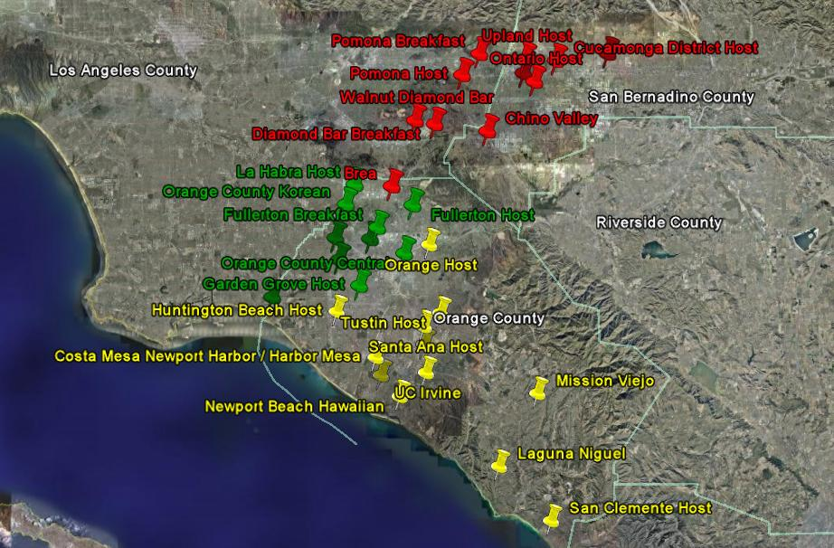
Brea

Slide 28
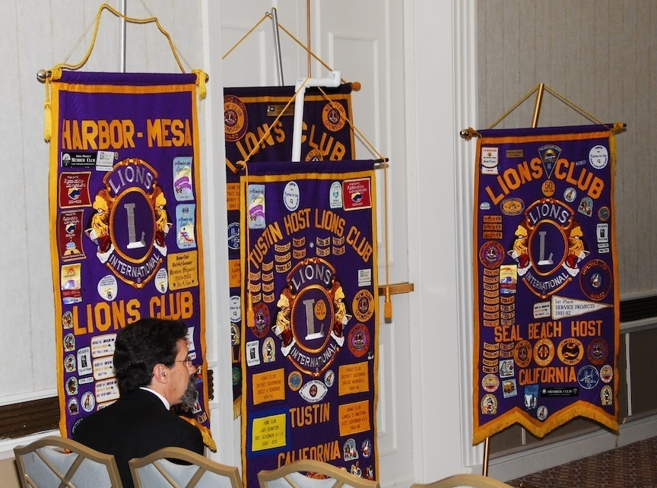
District 4-L4
Annual District 4-L4 Convention
May of each year
District 4-L4 Meetings
District – 4 per year
Region – 2 per year
Zone – 3 or 4 per year

Slide 29
District 4-L4 Officers
District Governor
1st Vice District Governor
2nd Vice District Governor
Cabinet Secretary
Cabinet Treasurer
Immediate Past District Governor
Region Chairs
Zone Chairs
Public Relations
District Newsletter Editor
District Photographer
District Chaplain
District Webmaster

Slide 30
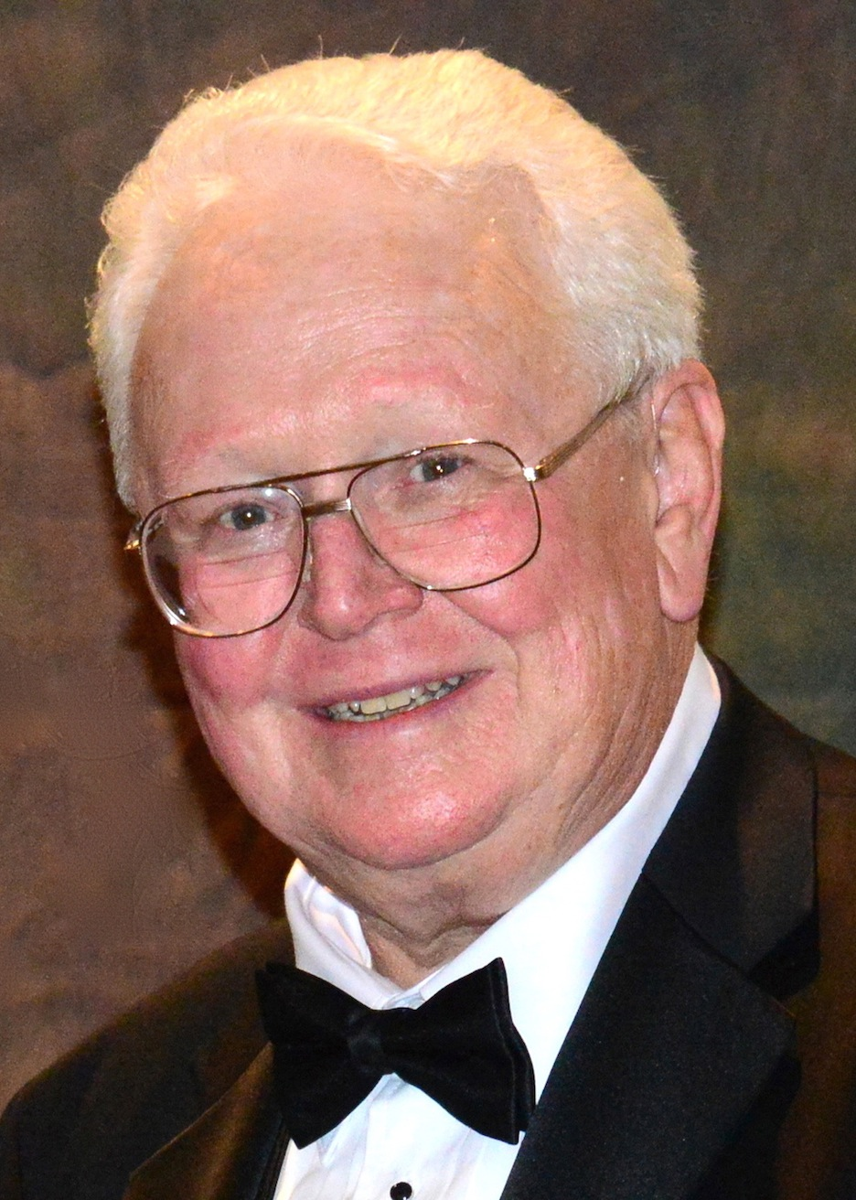
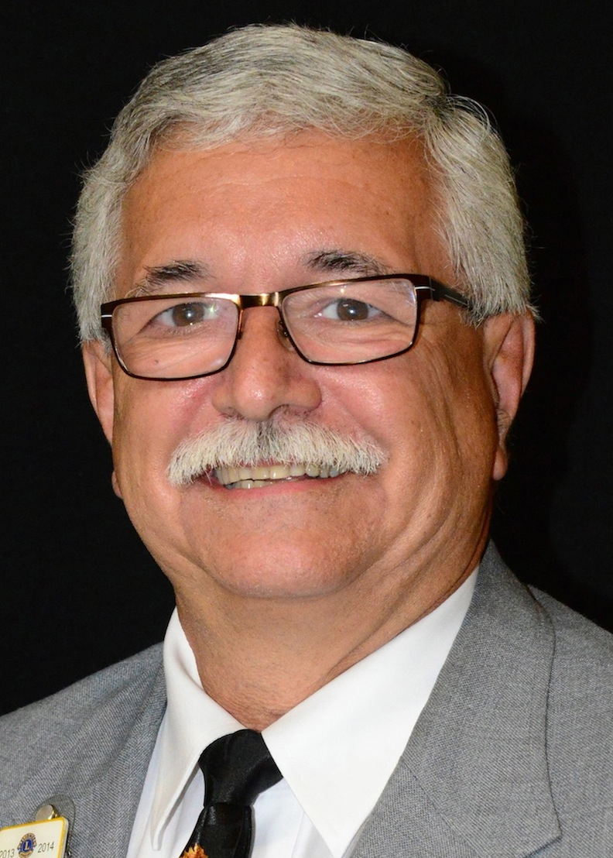
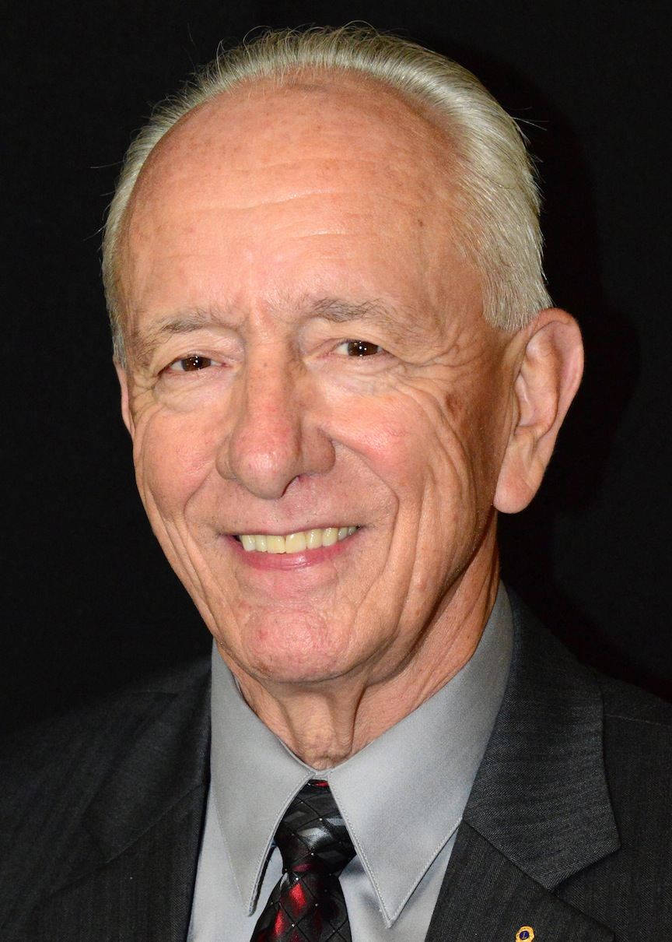
District 4-L4 Officers
District
Governor
Gil Smith
First Vice District Governor
Ken Myers
Second Vice District Governor
Bob Susaeta

Slide 31
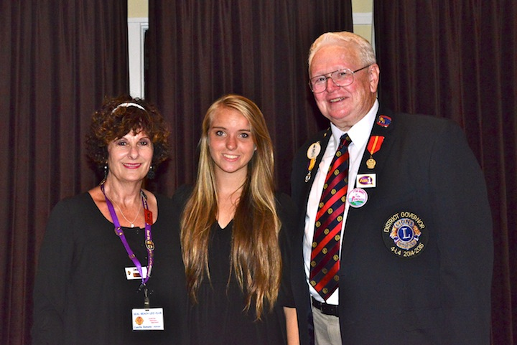
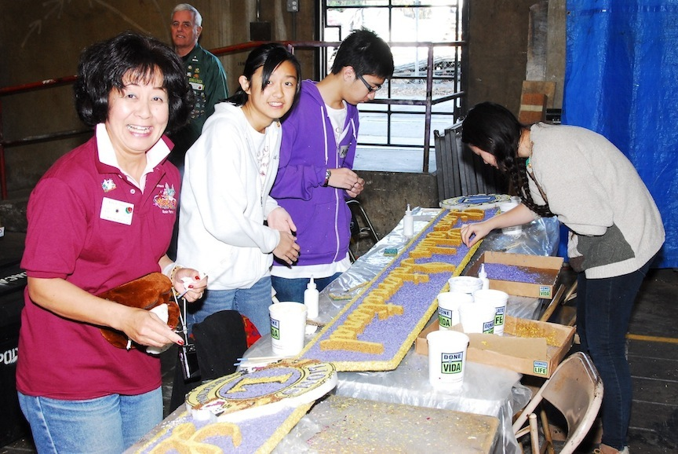
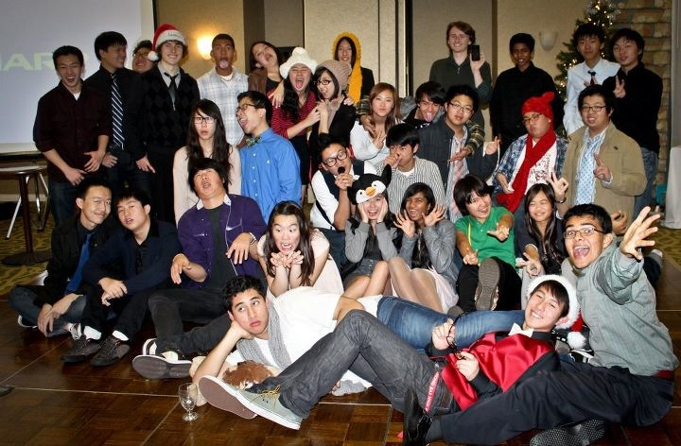
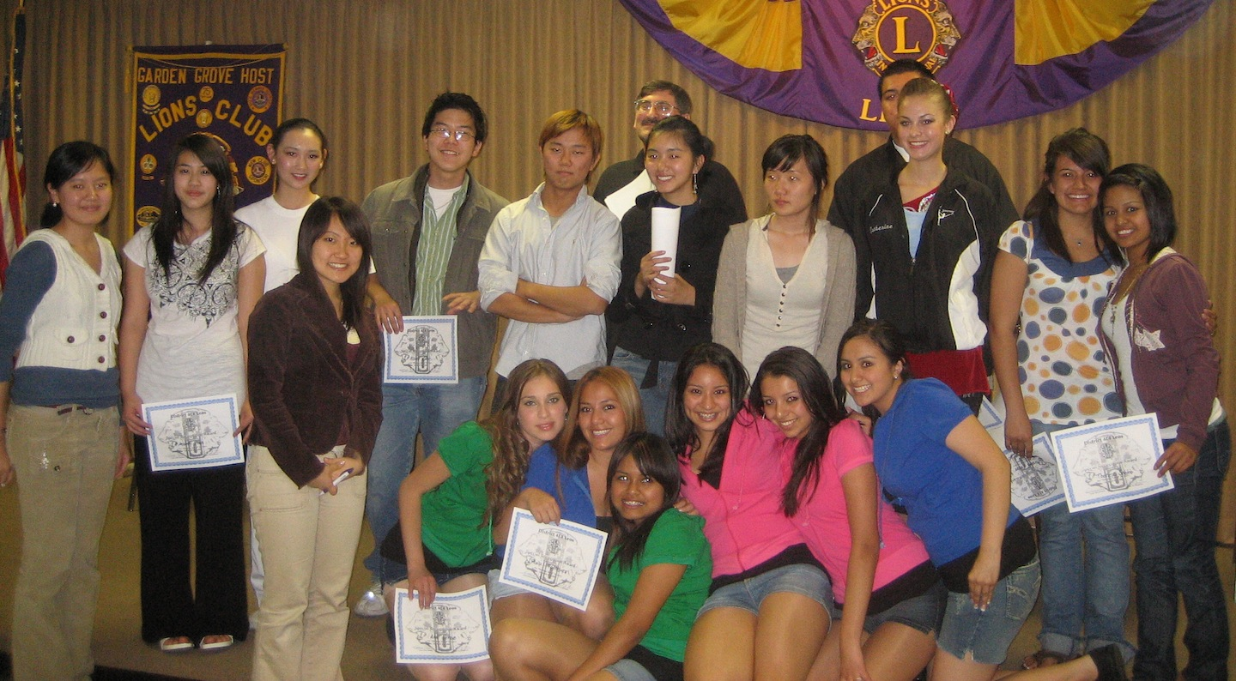
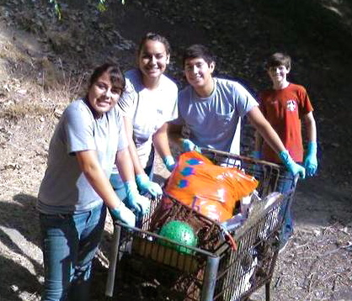
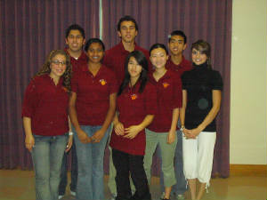
District 4-L4 Leo Clubs
22 clubs (as of 2014)

Slide 32
District Communications
FORUM – Monthly newspaper sent by e-mail and/or on the website
Webpage www.e-district.org/sites/4l4
E-Blasts – E-mail letters and flyers sent to district officers, club presidents and secretaries on timely topics

Slide 33
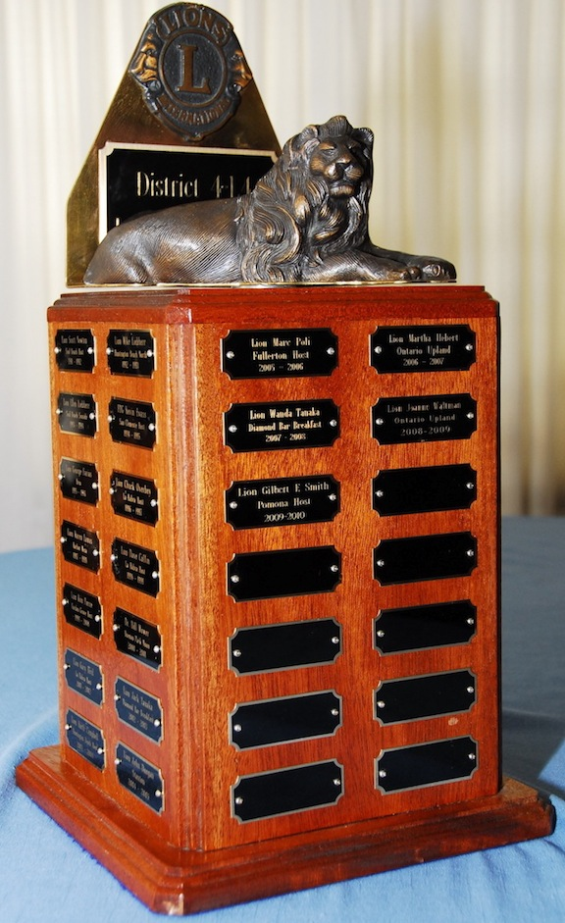
District Contests
• Lion of the Year
• Lions Club of the Year
• President of the Year
• Secretary of
the Year
• Club Excellence
• Secretary Excellence
Membership – Largest % increase by a club
Membership – Most new members by Lion, Club
Visitations
Roll Call
Club Bulletin
Lion of the Year Trophy

Slide 34
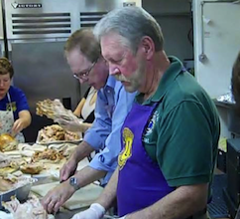
District Approved Projects
American Family Housing
Asian American Senior Citizen Service Center
Blind Children’s Learning Center
Blood Bank Donations
Braille Institute of America, Inc.
California Friends in Sight
City of Hope
Diabetes Awareness

Slide 35
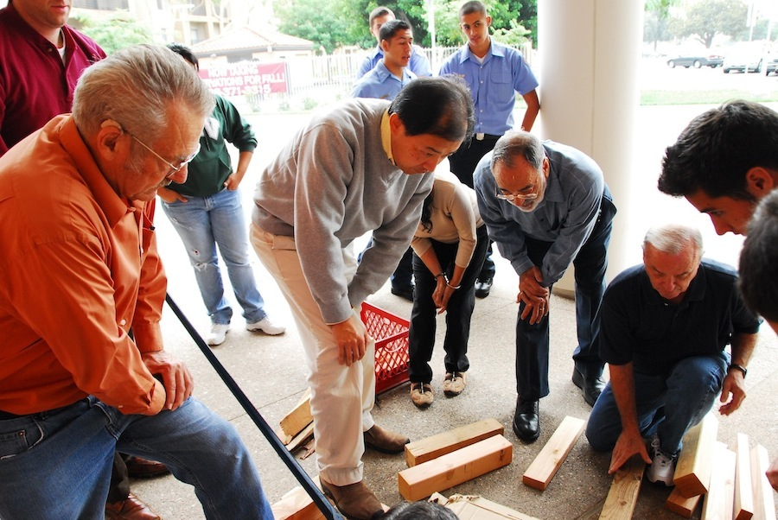
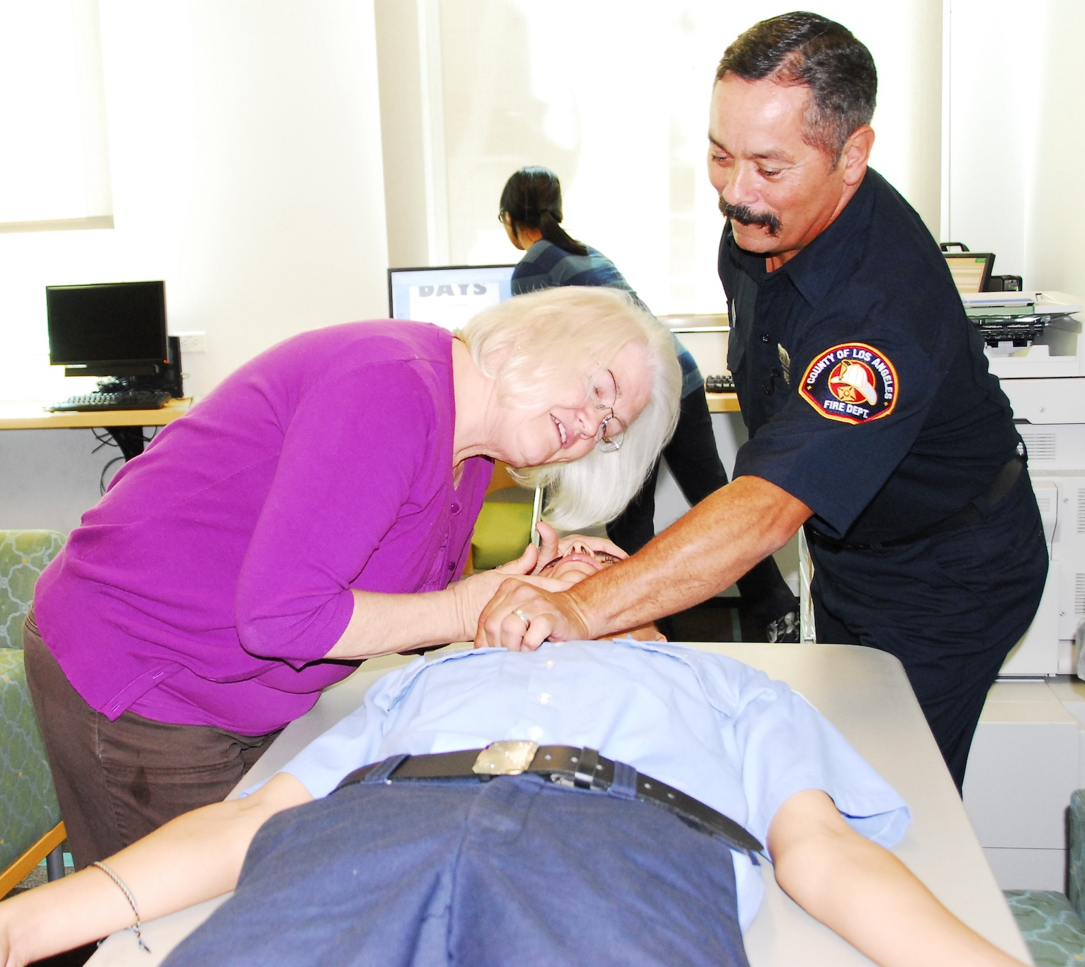
District Approved Projects continued
Disaster Preparedness and Relief
District 4-L4 Pajama Party
Environment
Guide Dogs of the Desert International, Inc.
Help for Brain Injured Children
Hearing Aid Bank Program

Slide 36
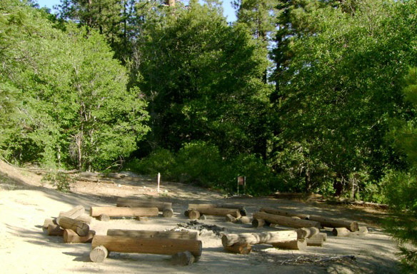
District Approved Projects continued
Hearing and Speech Action
Junior Blind of America
Learning Ally (Recording for the Blind and Dyslexic)
Lions Quest
Lions Camp at Teresita Pines
Lions Hearing Clinic and Research Center Foundation

Slide 37
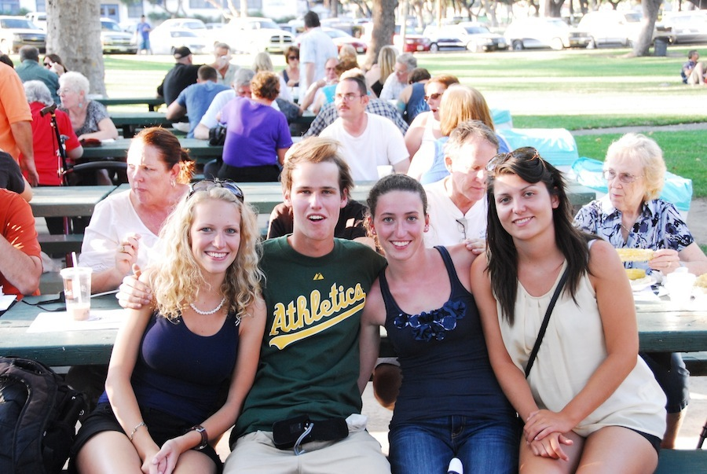
District Approved Projects continued
Lions Project for Scleroderma Cure
Lions Sight and Hearing Foundation of Southern California
Lions Youth Exchange Foundation, Inc.
MD4 Lions Rose Parade Float

Slide 38
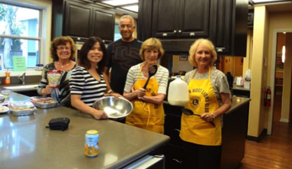
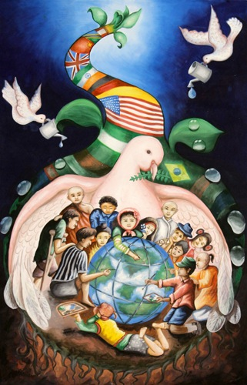
District Approved Projects continued
Medic Alert
Orange County Ronald
McDonald House
Peace Poster Contest
Student Speakers Foundation
Teen Recognition Program
The Orphanages of Thailand, Inc.
Vision Walk

Slide 39
Share A SPECIAL
LIONS MOMENT

Slide 40
MULTIPLE DISTRICT FOUR MD4 Serving the State and the World

Slide 41
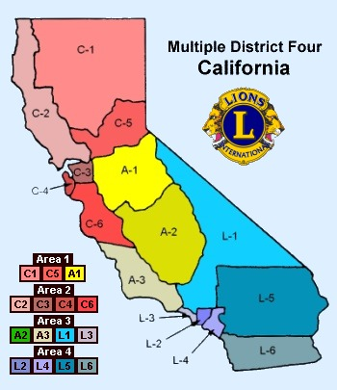
MD4
www.md4lions.org
Membership 20,205 Lions
Clubs about 720
MD-4 Districts (15)
C - Northern California (6)
A - Central
California (3)
L - Southern California (6)

Slide 42
MD4
Four Areas
Area 1 – Districts C-1, C-5, A-1
Area 2 – Districts C-2, C-3, C-4 & C-6
Area 3 – Districts A-2, A-3, L-1 & L-3
Area 4 – Districts L-2, L-4, L-5 & L-6
Annual MD-4 Convention
February of each year
MD-4 Council of Governors
15 Governors
1 Council Chairman, 1 Vice Council Secretary, 1 Vice Council Treasurer
Assisted by 1 Office Manager and 1 Part-time Secretary

Slide 43
Proud Lion Awards
Completion of 5 Tasks within 12 months
Attend a club board meeting.
Participate in a club service or
fund-raising activity.
Introduce a new prospective
member to the club.
4. Make a visit to another club.
Attend a zone, region, district, multiple district or international convention; report back to the club.
Orientation within 3 months is also suggested.

Slide 44
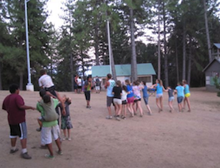
MD-4 Lions Endorsed Projects
California Friends in Sight
California Lions Camp (Camp Pacifica)
City of Hope
Diabetes Awareness
Ear of the Lion (The Hearing
Foundation)
Folsom Project for the Visually Impaired
Guide Dogs of the Desert
Guide Dogs for the Blind

Slide 45
MD-4 Lions Endorsed Projects continued
Junior Blind of America
Kases for Kids
Leader Dogs for the Blind
Learning Ally (Recording for
the Blind and Dyslexic)
Lions Camp at Teresita Pines
Lions Eye Foundation of
California/Nevada

Slide 46
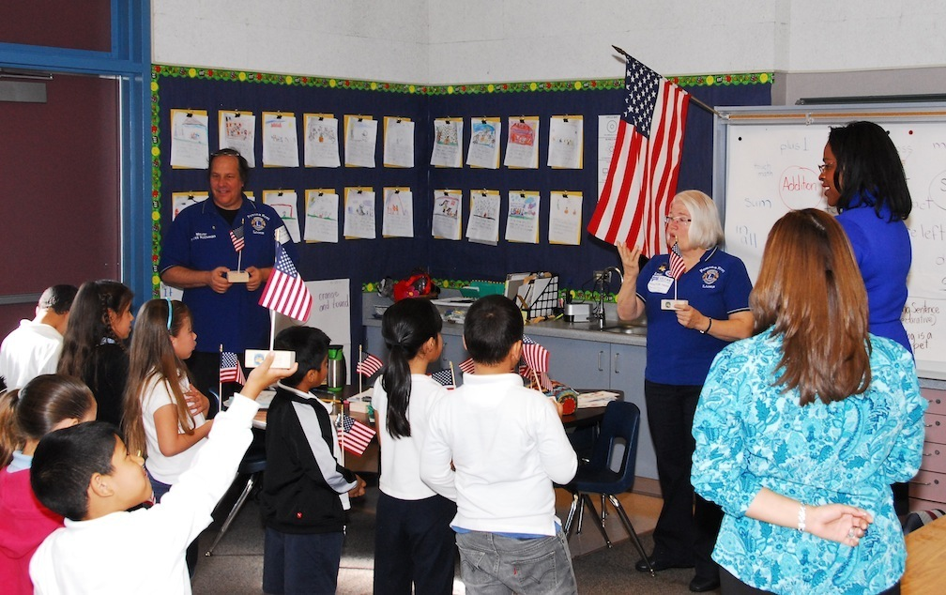
MD-4 Lions Endorsed Projects continued
Lions Flag Day
Lions Floats, Inc.
Lions Hope Foundation, Inc.
Lion in Sight
Lions Low Vision Services Program
“L.O.V.E.”
Lions Canine Companion for
Independence

Slide 47
MD-4 Lions Endorsed Projects cont.
Lions Sight and Hearing Foundation of Southern California
Lions Wilderness Camp for Deaf
Children, Inc.
Student Loans
Student Speakers Foundation
Western Lions Ear Foundation
White Cane Days, Inc.
World Services for the Blind
Youth Exchange Foundation

Slide 48
Share A SPECIAL
LIONS MOMENT

Slide 49
Lions Clubs International (LCI) Lions Clubs International Foundation (LCIF) Serving the World

Slide 50
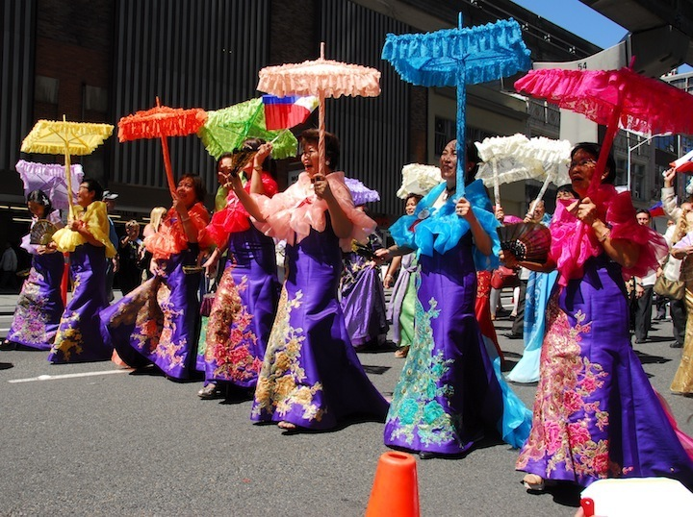
Lions Clubs International
http://www.lionsclubs.org
Slogan – Liberty Intelligence Our Nation’s Safety = LIONS
(Current alternate version is Loving Individuals Offering Needed Service)
Membership – 1.37+ million members, 46,000 clubs and 754 districts in over 200 countries and geographic areas.
Headquarters – Oakbrook, IL
Annual International Convention
Late June or July of each year
USA-Canada Forum – September

Slide 51
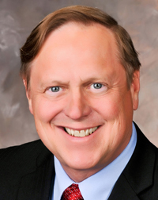
Lions Clubs International
Executive Officers
President - Joe Preston
from Arizona
“Strengthen the Pride”
1st Vice President – Dr. Jitsuhiro Yamada
2nd Vice President – Robert Corlew
Immediate Past President, Serves as Chairperson of LCIF – Barry Palmer

Slide 52
CENTENNIAL SERVICE CHALLENGE
100 Million Acts of Service for
100th Anniversary of Lions
- Engaging Our Youth
- Sharing the Vision
- Relieving the Hunger
- Protecting Our
Environment

Slide 53
Lions Clubs International
International Directors
14 Directors in the United States
20 Directors outside United States
(Each year one-half of directors are elected for a 2-year term)
Official Colors – Purple and gold
World’s largest non-profit service club organization

Slide 54
Lions Clubs International
THE BENEFITS OF LIONS CLUBS
Unparalleled satisfaction of helping those in need
Making a difference in your community
Having an impact on those in need worldwide
Developing leadership skills
Enhancing communication skills
Utilizing planning and organizational skills
Working hands-on to meet the community needs
Meeting new people – from your community and abroad
Opportunities to network
Opportunities to travel

Slide 55
Lions Clubs International
Leo Clubs Worldwide
144,000 Leos 5,738 Clubs
115 Districts 142 Countries
LCI Communications
LION Magazine
Website - lionsclubs.org

Slide 56
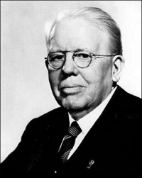
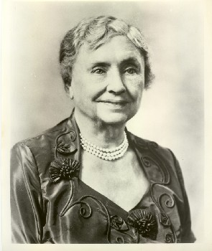
LCI HISTORY
Beginning in 1917
Melvin Jones, a 38-year-old Chicago business leader, asked a simple and world-changing question – what if people put their talents to work improving their communities?
1920: Going International
Canada, then Mexico -- In 1950s-60s in Europe, Asia, Africa
1925: Eradicating Blindness
Helen Keller – Asked Lions to become “Knights of the Blind in the crusade against darkness.”
Melvin Jones
Helen Keller

Slide 57
LCI HISTORY
1945: United Nations
Assisted in the drafting of the UN Charter – continuing close relationship
1957: Organizing Youth Programs
Created the Leo Program.
1968: Establishing Our Foundation
Large scale local and global humanitarian projects
1990: Launching SightFirst
Raised more than $346 million
Today: Extending Our Reach
Our international network has grown to include more than 200 countries and geographic areas.

Slide 58
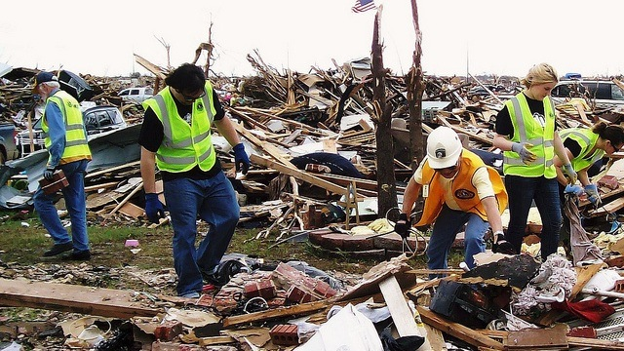
Lions Clubs International Foundation (LCIF)
Melvin Jones Fellowship
Highest form of recognition – Money goes to LCIF.
LCIF is charitable arm of LCI.
Supports areas of service:
Preserving Sight
Serving Youth
Disaster Relief
Humanitarian Efforts

Slide 59
LCIF By the Numbers
$415,000,000 raised for
Sight First, which has saved
the sight of millions of
people worldwide.
8,000,000 cataract surgeries
performed through SightFirst.
$100,000,000 given in last 10 years
for disaster relief.
120 million children served by
Lions Needs-Based Eye Care Center.

Slide 60
LCIF By the Numbers
17,000,000 children screened by Sight for Kids. (plus local club screenings)
350,000 Special Olympics athletes screened by the Lions Opening Eyes Program.
30,000,000 people have had serious vision loss prevented.

Slide 61
LCIF By the Numbers
57 million children (2012)
vaccinated against measles in
Ethiopia, Madagascar, Mali and
Nigeria. Measles is a leading
cause of childhood blindness. 450 kids die per day. Campaign goal: Vaccinate 157 million – wipe out measles.
150,000,000 doses of Mectizan have been given to people in 14 countries to control river blindness. Lions are wiping out river blindness.

Slide 62
LCIF By the Numbers
• 100,000,000 people have
been provided with
improved eye care.
• 650,000 eye care
professionals have been
trained.
• 315 eye hospitals have
been built and thousands
of others upgraded or given
equipment.
• 120 villages received access to clean water.

Slide 64
Share A SPECIAL
LIONS MOMENT

