Slide 1
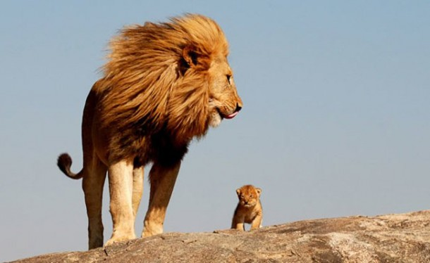
TAKING PRIDE IN THE PRIDE

Slide 2
STRONGER DISTRICTS BY RESISTRICTING OR MERGING DISTRICTS

Slide 3
BACKGROUND
75 COUNTIES
240 MILES – NORTH TO SOUTH
275 MILES – EAST TO WEST
53,104 SQUARE MILES
EACH CURRENT DISTRICT 13.3K SQ. MILES
OR 112 MILES X 119 MILES (APPROXIMATLY)

Slide 4
BACKGROUND CON’T
STATE POPULATION
MD 7L – 464.6 K (17 COUNTIES)
MD 7I – 1051.2 K (18 COUNTIES)
MD 7O – 941.3 K (19 COUNTIES)
MD 7N – 458.8 K (21 COUNTIES)
2010 POPULATION 2915.9 K
2016 POPULATION 2989.5 K
2% GROWTH
PROJECTED GROWTH NEXT 10 YEARS IS
-2.9 TO 1.4 THOUSAND (US CENSUS)

Slide 5
MD 7 MEMBERSHIP
YEAR MEMBERS ADDED MEMBS. DROPPED
2009-10 664 703
2010-11 559 793
2011-12 511 547
2012-13 494 658
2013-14 582 551
2014-15 547 610
2015-16 440 565
AVERAGE 542.4 632.4
2016-17 167 252

Slide 6
FINDINGS
MEMBERS REQUIRED PER DISTRICT - 1250
CLUBS REQUIRED PER DISTRICT – 35
DECEMBER 31, 2016 MULTIPLE DISTRICT 7
MEMBERSHIP CLUBS
L 797 30
I 876 39
O 672 30
N 735 33
MERGED DISTRICTS
I & O 1548 69
L & N 1532 63

Slide 7
DISTRICTS IN ARKANSAS
YEAR NUMBER OF DISTRICTS
1918-1932 1
1932-1933 3
1933-1947 2
1947-1959 3
1959-1972 4
1972-1992 5
1992-2017 4
2017-? ?

Slide 9
WHY MERGE DISTRICTS
After numerous membership drives in each
district, no improvement in membership
Membership trend continues to show loss of
members
Grants available now (may not be in the future)
to offset any cost
Districts too small
- Not enough members for leadership
position
- Repeat governors, district and state chairs

Slide 10
MERGE TO 2 DISTRICTS
PROS
^ Will be in compliance with LCI
^ Eliminate need for redistricting in the
immediate future
^ Provide larger membership pools from
which to draw leaders
- Fewer Lions having to hold multiple
offices
- More Lions available to fill these
offices

Slide 11
MERGE TO 2 DISTRICTS
PROS CONTINUED
- More Lions available may increase the
quality of leaders
^ Improve District and State Council finances
- More members/district increases
administrative revenues
- Fewer districts could possibly reduce
state council expense
^ Spouse/Guest of District Governor expenses
paid when attending international convention
^ MD 7 eligible for a International Director

Slide 12
MERGE TO 2 DISTRICTS
CONS
^ Increases the number of clubs/district
- Current 30 – 39 clubs
- Post 66 Clubs
^ Merging 4 districts to 2 will be difficult
- Election and reorganization of
officers
- Transition of reports, directories,
and financial goals
- Acceptance of ownership by
leaders

Slide 13
MERGE TO 2 DISTRICTS
CONS
^ New district leaders may not feel
sense of urgency to grow new
members.
^ District Governors will have more
miles to travel visiting clubs in
their district

Slide 14
RECOMMENDATIONS
Present proposal to districts and clubs
at their cabinet meetings, districts
conventions, and zone meetings
Present to state convention for approval
April 2017 and determine MD 7 district’s
identification; i.e. 7N and 7S
If approved by LCI implement July 1,
2019

Slide 15
IMPLEMENTATION PLAN
2016-17 Present proposal to leadership and
membership
- Prepare changes to state constitution
May 2017 send plan to LCI for approval
2017-18 Hold “new” district conventions
- Approve State Constitution change
- Appoint election committee
- Develop rules for convention
- Solicit candidates for 2018-19
- Elect officers for 2018-19

Slide 16
IMPLEMENTATION PLAN
2018-19 Transition to new leadership
- Hold “meet and greet” meetings
- Train Governors teams
- Reinstitute Region Chairs
- Appoint state committee chairs
- Develop budgets
- Revisit chnages in district
constitution

Slide 17
IMPLEMENTATION PLAN
2019 - Following International
Convention hold 2 district
conventions and cabinet
meetings
- Approve district constitutions,
budgets and committees

