Slide 1
Social Media Course
Lions Learning day
2021 – 2022

Slide 2
Instructors – PDG Frank Hewitt & PZC Kate Hewitt

Slide 3
What we will be exploring together today
Why use Social Media
5 ways to increase Your Club’s Social Media Engagement
Social Media Tips
How to Use Hashtags
Create a Hashtag for your Lions or Leo Club
Publicity Ideas
Phishing Protection for Lions

Slide 4
Why use Social Media
Lions can use social media to make a bigger impact:
Connect with other community organizations, leaders and the general public to spread the word about your club
Show your local and global community how you serve.
Engage current and potential members
Create a fundraiser to support LCIF
Notes:
Connect with other community organizations, leaders and the general public to spread the word about your club.
Show your local and global community how you serve.
Engage current and potential members.
Create a fundraiser to support LCIF

Slide 5
5 Ways to increase your Club’s Social Media Engagement
1. Content and Photos
Notes:
Build a positive image through interesting content and captivating photos. Make sure your posts are informative, but short. Try to use hashtags and always make sure to use the correct Lions logo.

Slide 6
5 Ways to increase your Club’s Social Media Engagement
2. Share your content
Notes:
Share your content
When your members share your club’s posts to their social media account you are able to reach a bigger audience and get more views!

Slide 7
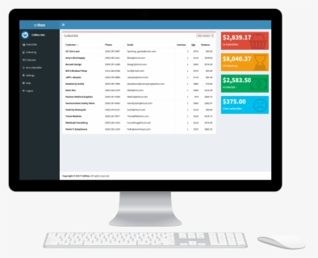
5 Ways to increase your Club’s Social Media Engagement
3. Integrate Social Media on Your Website
Notes:
Integrate Social Media on Your Website
Connect your social media with E-Club House. Make sure to use buttons and links below any content. Have links on your E-club House and blog that take readers to your social media accounts.

Slide 8
5 Ways to increase your Club’s Social Media Engagement
4. Use Traditional Media
Notes:
Use traditional Media
Newspaper ads or write ups, radio ads and fliers can help get the word out about your club. Make sure to mention your social media accounts to help gain viewers.

Slide 9
5 Ways to increase your Club’s Social Media Engagement
5. Utilize Page Statistics
Notes:
Utilize Page Statistics
Statistics show what posts are most popular among your viewers. This will help you choose future content.

Slide 10
Give these Tips a try!
See how social media CAN work for your club!

Slide 11
Hashtags and how to use them

Slide 12
#Lions Club #Leo Club #LionsEverywhere
What is a Hash Tag?
hash-tag
haSHtag/noun (on social media sites such as Twitter) a word or phrase preceded by a hash or pounds sign (#) and used to identify messages on a specific topic.
Notes:
What is a Hashtag?
- it is a word or phrase preceded by a hash or pound sign and it is used to identify messages on a specific topic
- When you add #LionsClub to a message on Twitter or Facebook, you're essentially joining a conversation. People on Twitter and Facebook can search for a specific hashtag, and your message will show up in those search results. Your hashtag is letting everyone know the great things that your Lions club is doing for the community.

Slide 13
Using Lions Hashtags
For General Club and Service related Posts:
#LionsClub
#LeoClub
#ProudLEO
#LionsEverywhere
#WeServe
#KindnessMatters
For International Lions Events:
#LCICon
#LDUN
For Program related posts:
#LionsYouthExchange
#LionsCamp
#PeacePoster
#SightForKids
Share YOUR STORIES
Notes:
- There is a handful of hashtags that we use in our social media communications, and we encourage Lions to use them, as well. Pick one or two hashtags under which your message falls; for example, if you're posting a photo of a recent Centennial Service Challenge activity, add #LIONS100 to the end of your message. Or if you're sharing photos from your convention experience, use #LCICon. For more general posts -- perhaps a simple photo of members at a local food pantry or library event -- use #LionsClub.
- Hashtags also help us share your stories with Lions everywhere. We'll often search for Lion’s hashtags on Facebook, Twitter and Instagram and post the stories on our official social media channels. Take pride in your service and help us share your story! #WeServe!

Slide 14
Create a Hashtag for your Lions or Leo Club
How to create a Hashtag for your club, District or Multiple District
Chose one that is short, easy to remember and defines your club.
Before deciding on a hashtag, search for it on Facebook, Twitter and Instagram to make sure it’s not already being widely used by a different group.
Promote the hashtag in your printed material and emails, and on Lions signs and gear, website and social posts
Ask members and the public to use it when posting photos on their social media at all of your events and activities.
Notes:
How to create a Hashtag for your Lions Club
- for example, Leos in Italy use #leoclubitalia: Lions in France use #lionsfrance
- Promoting a hashtag for your club is a great way to encourage social media participation from all of your members and the public across all channels. Your members and your community do not need access to your club’s social accounts to use the hashtag. They just post on their own accounts, add the hashtag, and there you go: instant, easy branding for your club that reaches a larger network!

Slide 15
Publicity Ideas How do I share Lions messages with the Public
Club Fact Sheet
Notes:
How do I share Lions messages with the Public.
- Use a combination of the following PR Tools and resources to share your message with the media and community members.
Club Fact Sheet
A club fact sheet will provide background information about your club to reporters. Include a fact sheet with all news releases. You can also use fact sheets as handouts during community events.

Slide 16
Publicity Ideas How do I share Lions messages with the Public
Club Fact Sheet
News Release
Notes:
News Releases
- News releases answer six key questions in the first two paragraphs: Who? What? When? Where? Why? and How? Subsequent paragraphs should provide additional information in descending order of importance. Simply written and fact-filled releases are more likely to be published. To increase the chances that your release will be used:
Be sure that it is about a newsworthy event.
Keep paragraphs and sentences short, limiting them to a single idea.
Use quotes to enhance basic information. When attributing quotes, be sure to identify the person's name and title.
Include the name of the appropriate contact person at the top of the page along with a daytime telephone number and e-mail address.
Follow a standard press release format (see the example release at the end of this guide for the format of news releases, and visit the Sample News Releases page to download pre-formatted fill-in-the-blank press releases).
At least two weeks before your event, distribute news releases to editors, reporters and news directors on your media list who cover your particular type of story.
If you have a major story, follow up with each media outlet one week before the event. Offer to answer questions and outline photo opportunities. Be positive and enthusiastic in explaining why their audience would be interested in your story.
Call your local media outlets to suggest a feature story to a reporter or editor in a situation when a news release might not tell the story well. Interest the reporter in covering a story, such as the importance of volunteers in your community rather than covering a specific event or activity.

Slide 17
Publicity Ideas How do I share Lions messages with the Public
Club Fact Sheet
News Release
Interviews and Public Speaking
Notes:
Interviews and Public Speaking - An appropriate club spokesperson should be prepared to provide accurate information with enthusiasm and confidence. Following are tips for successful interviews:
Know Your Facts. Be ready to expand upon the who, what, when, where, why and how stated in media material.
Prepare Key Message Points. Rather than answer a question with a simple "yes" or "no," use the interviewer's question as a bridge to your key messages. Practice answering likely questions prior to the interview. Review the association's key messages on the LCI website and adapt them to fit your club's messages.
Give Short, Clear Responses. Mention your main points early in the interview in a few, brief, clear sentences. If you do not know the answer to a question, offer to find out the answer and follow up immediately.
Mention Your Club's Name Often. Avoid saying only "I" or "we."
Watch What You Say. Never give "off the record" comments.
Dress Appropriately. Always wear your Lions pin. For television, avoid pinstripes, white shirts, loud prints and too much jewelry.
Smile. Be conversational. Let the reporter see that you enjoy being a Lion.

Slide 18
Publicity Ideas How do I share Lions messages with the Public
Club Fact Sheet
News Release
Interviews and Public Speaking
Post-Event Publicity
Notes:
Post-Event Publicity - Report the results of your programs and fundraisers to the community through the following:
News Release. Prepare a brief, one page news release highlighting the project's results. Include photos.
Letter to the Editor. Write a thank you note to the community.
Display Advertisement. Consider placing a small advertisement thanking the community for its support. Many publications offer not-for-profit discounts. Some will even donate unsold space free of charge.

Slide 19
Publicity Ideas How do I share Lions messages with the Public
Club Fact Sheet
News Release
Interviews and Public Speaking
Post-Event Publicity
Public Service Announcements (PSAs)
Notes:
Public Service Announcements (PSAs) - PSAs are brief (10, 15 or 30 second) messages aired at no charge on radio and television stations as a community service. They must benefit the community, not just your club.
Lions Clubs International has a collection of PSAs covering a variety of topics that are available at no cost to clubs, including broadcast quality PSAs in MPEG format for television stations to download.
When writing a PSA, brevity and clarity are of utmost importance since at most you have 10 to 30 seconds to communicate your message. Messages about preventing blindness, serving youth, fundraising events that benefit the community and public events sponsored by your club are appropriate subjects. PSAs need to:
Get the listeners' attention.
Show how listeners will benefit from doing what you suggest.
Tell listeners where to go, what to do, when to do it and where to call for more information.
As a general guideline, a 10-second spot will have approximately 20 words and a 30-second spot will have approximately 65.
Contact the news or public service director at your local television or radio station to learn the station's scheduling and format requirements and if they can assist you with production. Often stations have a reduced production rate for not-for-profit organizations.

Slide 20
Publicity Ideas How do I share Lions messages with the Public
Club Fact Sheet
News Release
Interviews and Public Speaking
Post-Event Publicity
Public Service Announcements (PSAs)
Public Access Television
Notes:
Public Access Television
Public access stations air PSAs, run videos of club activities, post club events on community bulletin boards and have club members participate in community talk shows. Contact the public service director at your local cable station regarding program opportunities.

Slide 21
Publicity Ideas How do I share Lions messages with the Public
Video Programs
Club Fact Sheet
News Release
Interviews and Public Speaking
Post-Event Publicity
Public Service Announcements (PSAs)
Public Access Television
Notes:
Video Programs
Show a video such as LQ-Lions Quarterly Video Magazine or PSAs at community events and when you meet with other community groups. View and order videos from the Lions News Network (LNN). You can also view videos on YouTube and download LQ on iTunes.

Slide 22
Publicity Ideas How do I share Lions messages with the Public
Video Programs
Websites and Social Networks
Club Fact Sheet
News Release
Interviews and Public Speaking
Post-Event Publicity
Public Service Announcements (PSAs)
Public Access Television
Notes:
Websites and Social Networks
Websites and social networking sites are excellent ways to let people know about your club. Use e-Clubhouse to create a club website with easy-to-use templates and free hosting. Once created it is important to keep your website updated and to include the site in your publicity materials.
Social networking sites such as Twitter, YouTube, Facebook, LinkedIn and Flickr are excellent for promoting Lions clubs. Ask a club member comfortable with social networking to create and regularly manage the club's pages on these sites. Include contact information, photos from recent projects, a statement of purpose and a list of upcoming events.

Slide 23
Publicity Ideas How do I share Lions messages with the Public
Video Programs
Websites and Social Networks
Printed Promotional Materials
Club Fact Sheet
News Release
Interviews and Public Speaking
Post-Event Publicity
Public Service Announcements (PSAs)
Public Access Television
Notes:
Printed Promotional Materials
Printed materials for promoting your event should:
Answer: Who, what, when, where and why.
Use clear concise language and include only necessary information.
Be eye-catching and printed with a laser printer or professionally printed.
Use a bold, easy-to-read font or typeface.
Feature prominently your club's name, contact information and the Lions logo.
You may be able to negotiate with printers or photocopy services to produce your flyers and posters at a reduced not-for-profit rate.
Have club members post flyers and posters throughout your area-at public bulletin boards, libraries, store windows, bus stops, train stations, etc. Ask local businesses and government offices to have them available for customers.

Slide 24
Publicity Ideas How do I share Lions messages with the Public
Video Programs
Websites and Social Networks
Printed Promotional Materials
Photographs
Club Fact Sheet
News Release
Interviews and Public Speaking
Post-Event Publicity
Public Service Announcements (PSAs)
Public Access Television
Notes:
Photos can enhance your club bulletins and promotional materials and should be sent to newspapers along with a news release. Display photos of your club's activities and people you've helped at a community event. When taking photos, remember:
Use a digital camera when possible. Digital photos are easy to send, save and store. Submit digital photos as attached files. Do not cut and paste them into an e-mail.
Use only clearly focused photographs.
Shoot candid rather than posed photos. While posed and group shots may be used in club bulletins, candid shots are much more interesting. Many publications will not use posed photos.
If you must pose people, make the photos look as natural as possible by having them do something. Carefully frame the photos so some people aren't cut off.
Get as close to the action as possible.
Limit the number of people and don't include too much background.
Shoot a lot of photos and select the best shots.
Call your local newspapers to see if and how they accept electronic photos.
To obtain permission to publish photos taken by your club, download our Photo/Video Authorization Form or Child Photo/Video Authorization Form.

Slide 25
Publicity Ideas How do I share Lions messages with the Public
Video Programs
Websites and Social Networks
Printed Promotional Materials
Photographs
LION Magazine
Club Fact Sheet
News Release
Interviews and Public Speaking
Post-Event Publicity
Public Service Announcements (PSAs)
Public Access Television
Notes:
LION Magazine
Receive national recognition for your club's service activity by submitting articles and photos to LION Magazine. While not all submissions can be published, here are some guidelines when submitting your story:
Submit detailed information – who, what, when, where, why and how – of your club's completed service project or fundraising activity.
Do not send images formatted for use on the Internet. Web images are too small and do not have the high resolution required for use in LION Magazine.
Include clear, candid, action photographs of Lions participating in the project. Be sure everyone in the picture is identified.
Do not send "grip-and-grin" photos (i.e. people shaking hands, check presentation, etc.).
Include the name, address, daytime phone number and/or e-mail address of a contact person who is familiar with the project.
Submit stories and photographs that meet these guidelines to LION Magazine, 300 W 22nd Street, Oak Brook, IL 60523 USA or e-mail. It often takes up to a year for chosen articles to appear in print.

Slide 26
Publicity Ideas How do I share Lions messages with the Public
Video Programs
Websites and Social Networks
Printed Promotional Materials
Photographs
LION Magazine
Other Publicity Ideas
Club Fact Sheet
News Release
Interviews and Public Speaking
Post-Event Publicity
Public Service Announcements (PSAs)
Public Access Television
Notes:
Other Publicity Ideas
There are many ways to tell your community about your Lions club and activities. If your club is sponsoring a community event:
Ask to have information posted on your community website or message board.
Pass out flyers or brochures about your club and its activities. If the event is a fundraiser, hand out information telling how the money will be used.
Display the Lions logo and club name prominently on all materials and at all activities and events.
Even when your club doesn't have a special event planned, you can:
Wear your Lions pin and apparel.
List your club in local phone books and community directories, along with a contact person and phone number. Keep this information up to date.
Put information about your club in "Welcome to the Community" packets offered by local agencies or chambers of commerce.
Invite community organizations to present information about their activities at club meetings and offer to present information at their meetings.
Display local Peace Posters at a library or community center.
Ask government and school district newsletters to include information about your club, especially if you are involved in a community or school project such as the Peace Poster Contest, a vision or diabetes screening, building a recreational center, etc.
Place a highway sign or marker outside your community. Keep it in good condition. You can purchase a highway sign from Club Supplies Sales Department.
Donate a subscription of LION Magazine to your local library. Contact LION Magazine Department for ordering information.

Slide 27
Sharing Events on Social Media
BEFORE:
Create a Public Event from Your Facebook Page
Schedule Your Event
Invite your Friends
Share the event
Share Updates
Notes:
Sharing Events of Social Media
Ready to make your event a success? Facebook is a great tool to utilize before, during and after the event for promotion, networking and recruitment.
BEFORE: Create a Public Event from Your Facebook Page
The Event feature on Facebook allows you to create a promotional space for your event that is connected to your club’s page. Your club’s page will be listed as the host.
Schedule your event – Include the event date, time, location, ticket info and schedule.
Invite your friends – The event page has an Invite feature to allow you to invite your page’s followers and your Facebook friends. They can mark if they’re going, interested or not going.
Share the event – Share the page link with members and encourage them to invite their Facebook friends. The more shares and invites of your event, the more people it will reach!
Share updates – As the event approaches, post updates to get people excited about the event.
To create an event from your computer, go to your Facebook page to create a post. Click the Event option and fill in the fields.

Slide 28
Sharing Events on Social Media
During:
Tell Attendees to Follow You on Facebook
Get a handle on things
Use a Hashtag
Make Friends
Notes:
Sharing Events of Social Media - 2
DURING: Tell Attendees to Follow You on Facebook
While you’re at the event, make sure attendees know your club has a Facebook page where they can learn more, stay updated, ask questions and connect with members.
Get a handle on things – Include your page’s URL or handle on all your printed materials, handouts and signage. For example, include the message “Follow @lionsclubs on Facebook!” or “Visit facebook.com/lionsclubs to learn more!” (Hint: Your Facebook handle starts with @ and is displayed under your Facebook profile picture.)
Use a hashtag – Does your club or event have a hashtag (#ChicagoWindyCityLions or #LCICon2019)? Consider coming up with a hashtag and including it on signage. Encourage attendees to post their photos to their social profiles using the hashtag or by tagging/mentioning your page’s handle.
Make friends – As you meet new people, ask if you can connect on Facebook through your personal profiles. Friend them on Facebook as you’re talking. Later, you can invite them to like your page through Facebook.

Slide 29
Sharing Events on Social Media
After:
Network, network, network!
Share photos on your club page
Share photos on members pages
Stay in touch
Notes:
Sharing Events of Social Media - 3
AFTER: Network, network, network!
Facebook is more than just a promotional tool – it’s a networking tool that allows you to connect with members of your community!
Share photos on your club page – Post photos of your event on your club’s page and your personal profile. Tag or mention any of the new Facebook friends you met during the event to expand your post’s reach.
Share photos on member pages – Encourage members to post photos to their personal profiles, and to include your hashtag and page handle. Share their photos on your page.
Stay in touch – Through your personal profile, message the new friends you connected with on Facebook. Follow up about the event, invite them to your next service activity, and share your club’s page so they can stay updated.

Slide 30
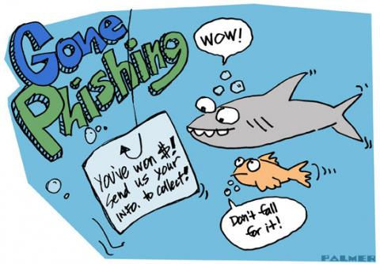
Phishing!
Notes:
See Phishing Notes:
- At Lions International they take pride in the service to others. These efforts bring notoriety and respect from communities worldwide. Unfortunately, this also attracts individuals that misrepresent themselves in order to gain access to personal information. When individuals use the internet to phone or commit this type of fraud it is commonly known as “phishing.”
- LCI systems are password protected for your safety and restrict access to personal information including email addresses and phone numbers. Outside of LCI systems, Club information is widely known through the media or non-LCI websites, and it is quite easy to obtain. This increases the chance of being contacted by a phisher.

Slide 31
Phishing protection for Lions
As a general protection when receiving unsolicited emails, do not follow embedded links in emails
If you should be redirected to a website, verify that the URL address starts with https://.
If contacted by another club member of the Association Headquarters via email, mobile text or social media and with a request for financial assistance, wire transfer, etc.
Notes:
To protect yourself a, your club and the Association from Phishing
- As a general practice when receiving unsolicited emails, do NOT follow embedded links in emails, especially if there is any mention of updating credit card information, personal data, PIN numbers or passwords. DELETE those emails immediately.
If you should be redirected to a website, verify that the URL address starts with https://. The single letter S after http indicates that it is a secure site, and is likely legitimate. If the URL is not secure, close your browser immediately.
If contacted by another club member or the Association Headquarters via email, mobile text message or social media, and there is a request for financial assistance, wire transfer, etc. do not reply to the message. Contact the club member or Association staff separately via email, phone, or through the MyLCI Communications Center to validate that the request is legitimate.

Slide 32
Phishing protection for Lions
Always use virus protection software on your PC or MAC
Exercise Caution when using public Wi-Fi systems
Create Strong passwords for all online accounts
NEVER store passwords in your email
Notes:
Always use virus protection software on your PC or MAC.
Exercise caution when using public Wi-Fi systems in a coffee house, restaurant, or internet café. These public systems offer no protection from unauthorized fraudulent monitoring.
Create strong passwords for your email, social media, and other online accounts, and update your passwords often.
Never store passwords, banking information, or credit card numbers in your email.

Slide 33
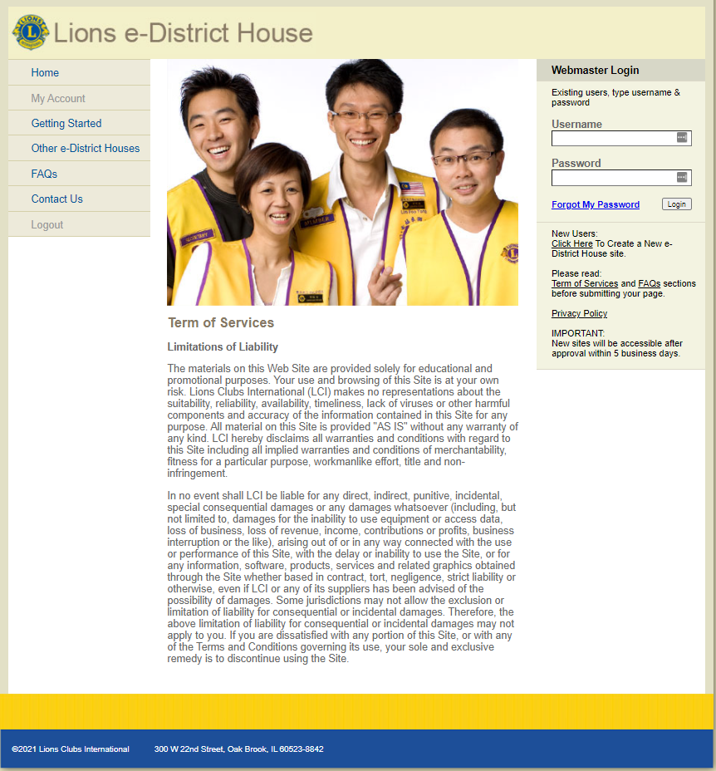
Create a Website: e-Clubhouse
If you're looking for a free and easy way to create a website for your Lions club, the e-Clubhouse is for you!
Submit an application to create a website for your Lions club today.
Notes:
Create a Website: e-Clubhouse
Lions Clubs International is proud to provide this resource to help Lions clubs around the world build a useful, professional looking website. Designed with fill-in-the blank fields for even the least Internet savvy, the e-Clubhouse allows you to:
Build and maintain a website for your club using a simple set of tools that make it easy to create a club website.
Keep your members – and community – up-to-date on the projects the club is working on.
Promote your club's activities – and recruit new members.
You can choose between two predesigned website templates that incorporate the Lions Clubs International brand. Both templates include links to information on the Lions Clubs International website, including the Lions News Network, Lions Learning Center and more.

Slide 34
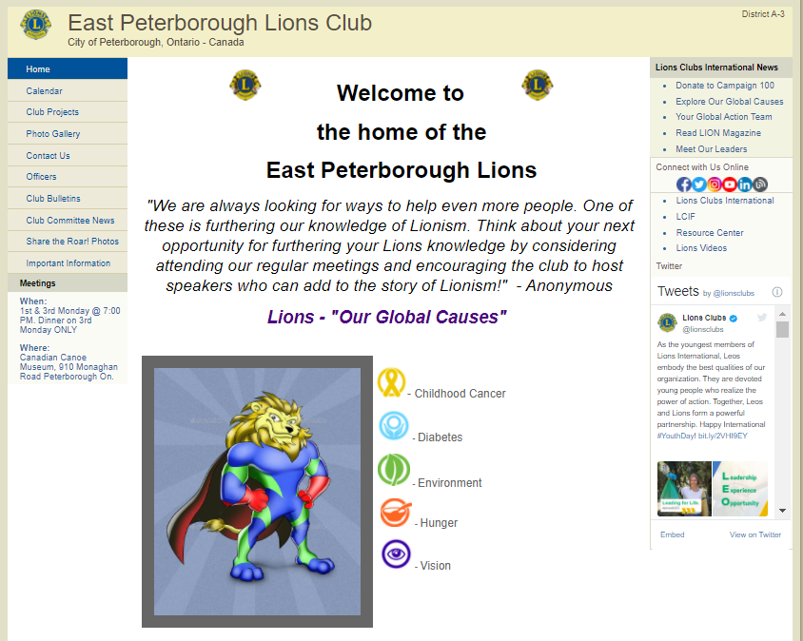
Create a Website: e-Clubhouse
Each e-Clubhouse site features:
Club Home Page
Calendar of Events
Club Projects
Photo Gallery
Contact Page
NEW Members ONLY features
Notes:
Each e-Clubhouse site features:
Club Home Page: Feature a photo of your club members participating in a project or club activity and provide a brief history of your club.
Calendar of Events: Use the calendar to keep everyone informed of important dates.
Club Projects: Provide information on your projects and let your community know how they can support your projects.
Photo Gallery: Showcase your club's activities by posting photos of recent projects.
Contact Page: Post key contact information for people in your community to call so they can learn more about your club and get involved.
Up to five additional pages for your club's special functions or news.
New Member-Only Features
A new member-only section is now available. This new section will provide a way for your members to communicate important club news, encourage attendance to meetings and recognize member dedication.

Slide 35
QUESTIONS

