Slide 1

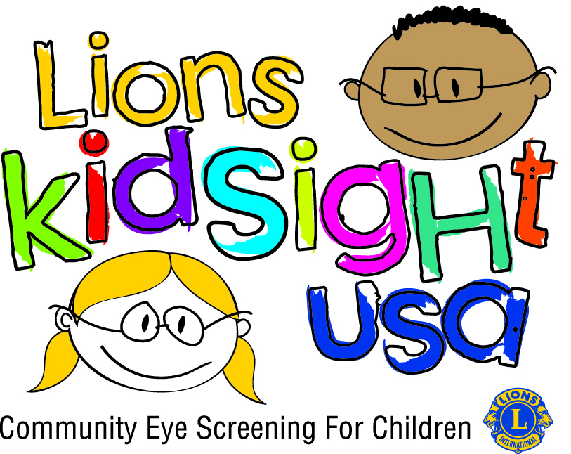
Children’s Vision Screening
Lions Clubs International
A Membership Tool

Slide 2
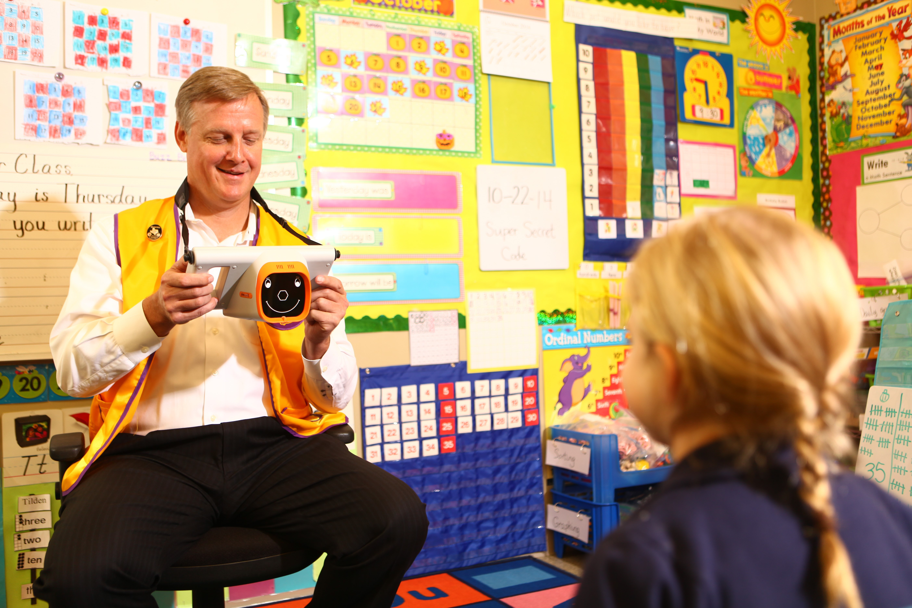
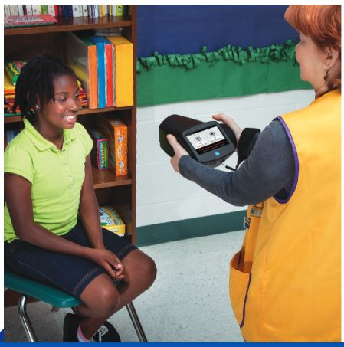
What is KidSight?
A Lions Program that uses a hand-held camera vision screening device (several options) for pre-literate children age 6 mos. to 6 years
Detects risk factors for amblyopia, refractive error, etc., before a child starts primary school.
These vision problems after age 7 are much harder to successfully treat.
Screening results are instantaneous
Cameras can be used by volunteers; cost about $6,000 to $7,000

Slide 3
Goals of Children’s Vision Screening
Primary Goal – Detection of amblyopia and its risk factors
Secondary Goal – Need for eyeglasses
Detect abnormal vision
Risk factors to visual development
Timely treatment with greatest benefit

Slide 4
Lions KidSight USA sets the standard
Lions KidSight USA has established nationally accepted, peer reviewed, procedural and referral standards, meeting the guidelines of all the professional eyecare organizations.

Slide 5
Effects of Poor Vision In The Young
  Poor literacy
  Behavioral disorders
  No participation in sports
  Poor socialization
  Other social/behavioral issues

Slide 6
AMBLYOPIA
Decreased vision in one eye relative to the other
Caused by
Unequal refractive error – one strong & one weak
Crossed eyes – strabismus
Congenital Cataract
Detect early, treat before age 6
Little benefit of treatment after age 8

Slide 7
Where Should Lions Screen
Where ever there is access to a large number of preschool and early elementary school aged kids
Day care centers/nursery schools, Camps, Religious Schools, Scouting Groups, etc.
Elementary Schools
High Schools are OK, but it is late for amblyopia treatment
Do NOT screen adults – does not detect adult eye disease like Glaucoma, Macular Degeneration, Diabetic Retinopathy, etc.

Slide 8
Bottom Line On Vision Screening
Lions can save a child’s sight
Lions can improve a child’s school performance
Lions can improve a child’s overall life experience
Lions can save a child’s life

Slide 9
Administrative Requirements
Parental consent to screen
Pass/Refer notice
Screening report

Slide 10
After a Referral Is Indicated
Screening team/agency must notify parent
Appointment with doctor made by parent
Screening team/agency follow up with parent
Screening team/agency have exam results sent to screening team/agency

Slide 11
How Does This Help Membership??
Every one of the steps in vision screening gives lions an opportunity to interact with the non-lion public in a positive way for the purpose of Service and making a difference in children’s lives

Slide 12
Benefits of Lions KidSight USA to clubs
Lions love doing screening
It is a meaningful project to which the public relates
Huge opportunity for community public relations

Slide 13
Lion’s Logo On
Everything The Public Sees
Promotional fliers
Permission forms
Referral letters
PR pieces in media
Material sent to doctors

Slide 14
Community PR
Radio/TV PR prior to screening
Lions appearing on radio/TV detailing success of screening
Newspaper interviews about screening and its goals
Fliers in town detailing screening, its goals and its successes
All of the above should have an invitation for the public to attend a meeting to learn more about the community service the Lions do

Slide 15
Parental Permission Form Front

Slide 16
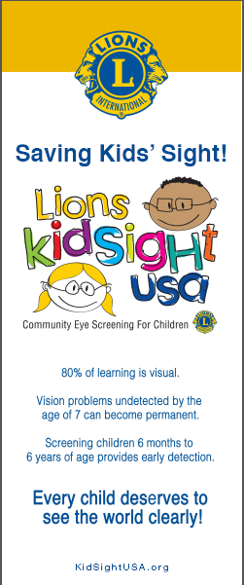
Banner Stand
Can be used on site
for event promotion

Slide 17
Upcoming Event Announcement
Can be sent to media or direct mail or handouts
for event promotion

Slide 18
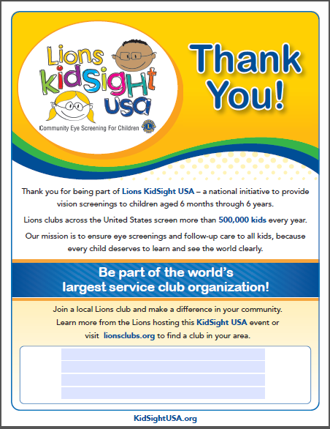
Screening Promotional Flier

Slide 19
Print this on back of all forms and letters

Slide 20
Post Event Announcement

Slide 21
District GMT Screening Advocate
Ask the district GMT Coordinator to learn about the KidSight program and processes
They can guide the clubs and districts doing screening to incorporate the PR and membership outreach into their KidSight program

Slide 22
Lions KidSight USA
Children’s vision screening led by LIONS doing a meaningful project with large community visibility with many opportunities for PR and membership growth

Slide 23
Lions making a real difference in the lives of children
Helping Lions Clubs improve their communities
Preventing children’s vision loss
Increasing educational potential
Improving long term quality of a child’s life
SAVING LIVES

Slide 24
Making a difference in communities
Making a difference in clubs
Website:
http://www.KidSightUSA.org
Lions Making A Difference for the next generation

